Slide 1
Oceans and Cryosphere
Basic Principles of Ocean Circulation (Fabrice Lacroix)
Global Ocean Carbon Cycle (Fabrice Lacroix)
3. Cryosphere (Mathias Goeckede)
Contact us @:
Fabrice: flacro@bgc-jena.mpg.de
Mathias: mgoeck@bgc-jena.mpg.de

Slide 2



About me
2009 – 2015 BSc/MSc ETH Zürich, Environmental Science (specialization: atmosphere and climate), Switzerland
2015 – 2019 PhD in natural Sciences, Max-Planck-Institute for Meteorology, Hamburg / Universite Libre de Bruxelles
-> Impacts of riverine fluxes on the global ocean carbon cycle (especially the coastal ocean)
2020 – Post-Doc at MPI-BGC, BSI department
-> Modeling of the effects arising from thawing of permafrost on nutrient and carbon cycling in high-latitude ecosystems

Slide 3
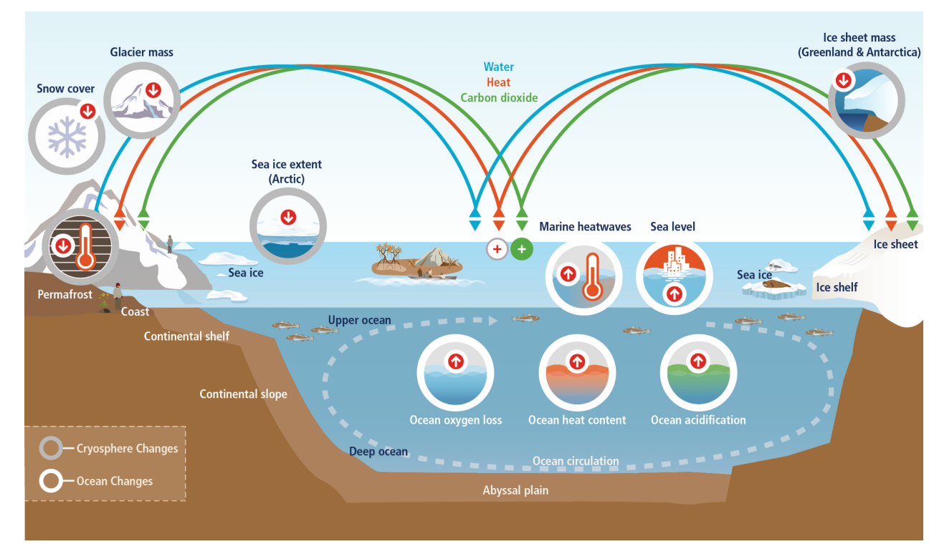
Setting the Scene: Ocean and Ice as part of the Climate System
Understanding the role of the ocean is a central pre-requisite for evaluating climate change feedbacks

Slide 4
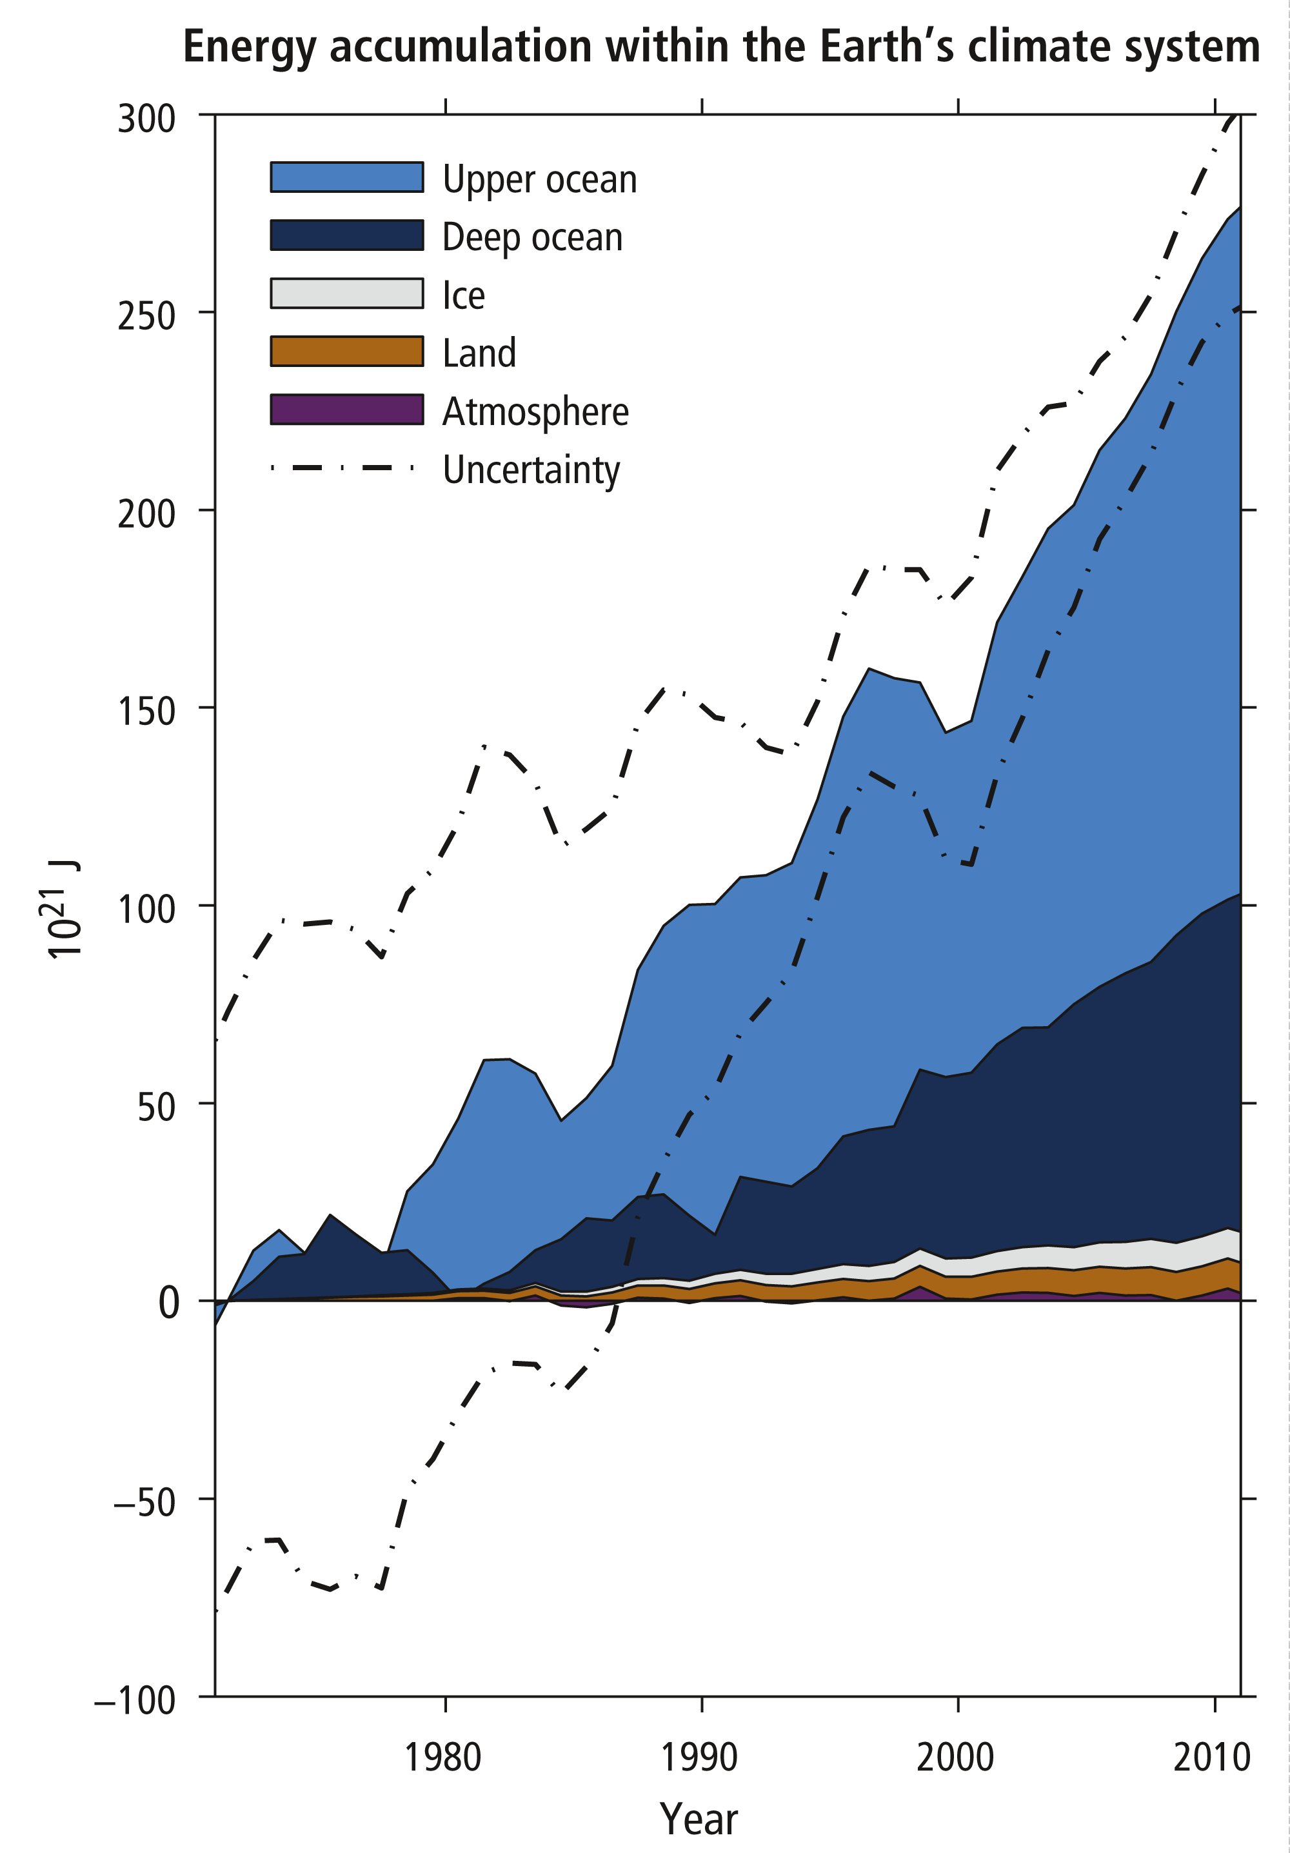
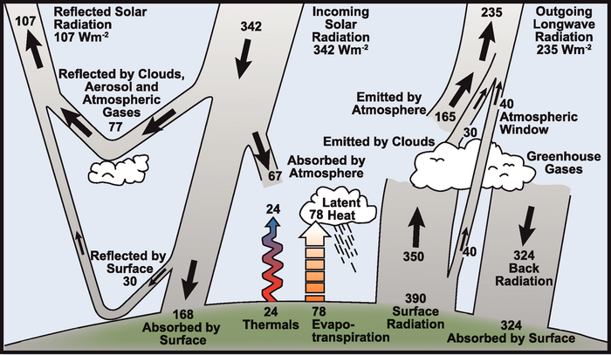
Setting the Scene: Ocean and Ice as Part of the Climate System
Earth‘s heat budget
IPCC 2013

Slide 5
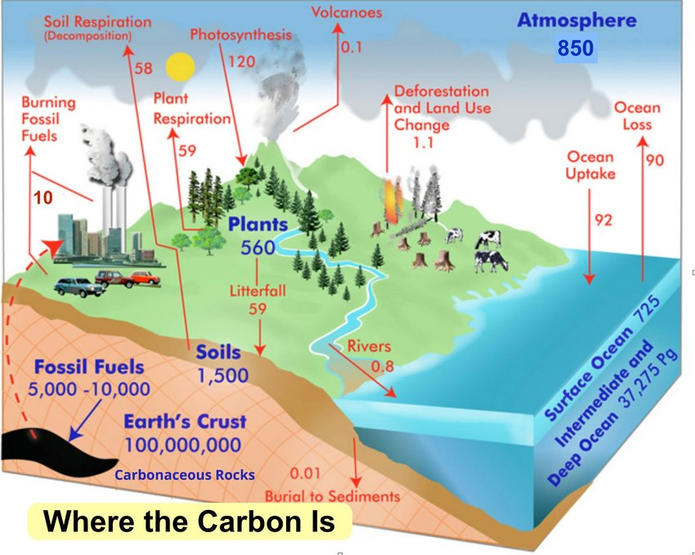
Setting the Scene: Ocean and Ice as Part of the Climate System
Global carbon cycle

Slide 6
Setting the Scene: Ocean and Ice as Part of the Climate System
Global carbon cycle
Need for understanding of the individual components to assess coupled feedbacks

Slide 7
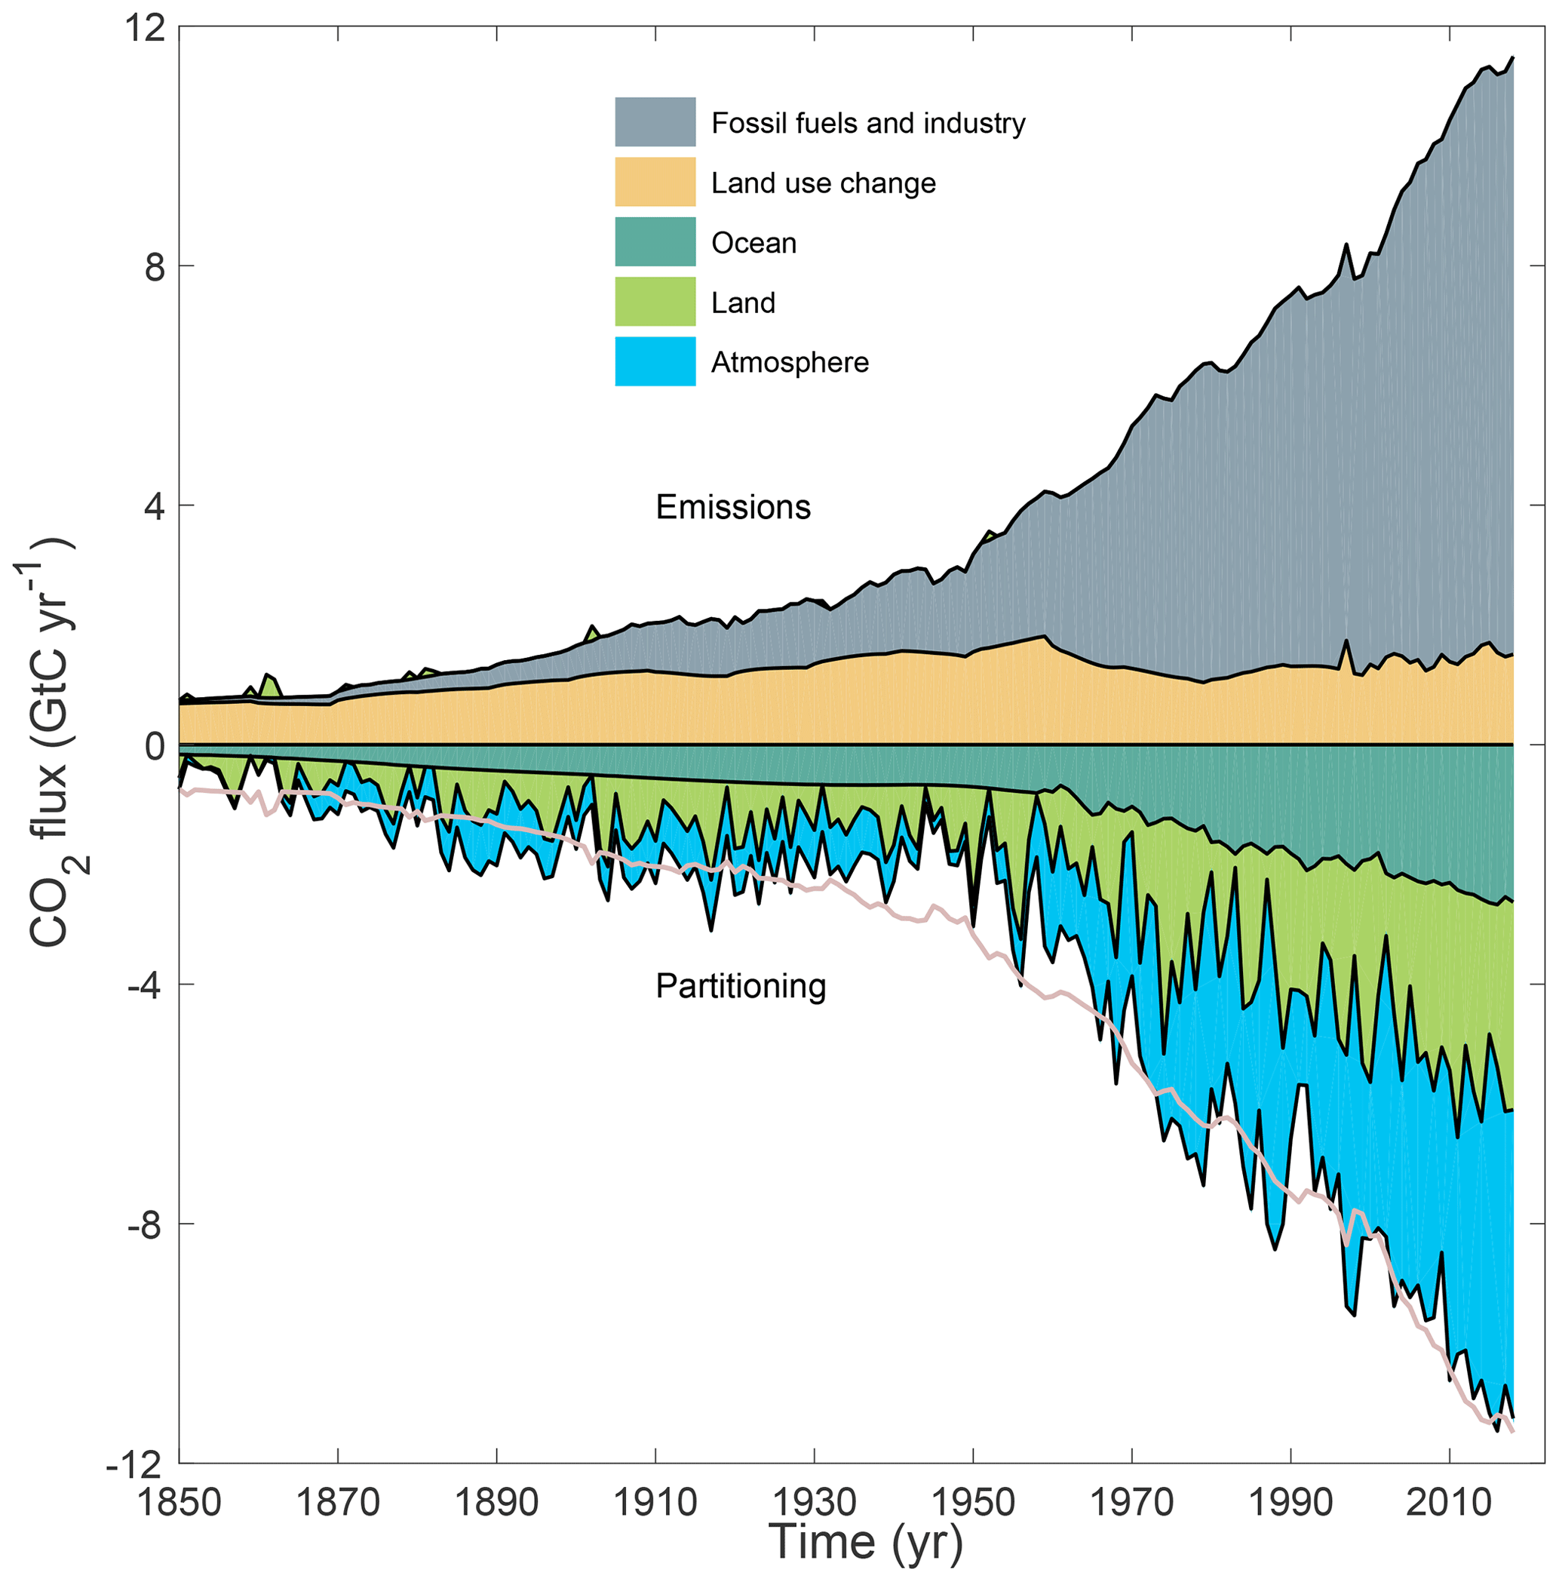
Setting the Scene: Ocean and Ice as Part of the Climate System
Global carbon cycle
Need for understanding of the individual components to assess coupled feedbacks
Global carbon project

Slide 8
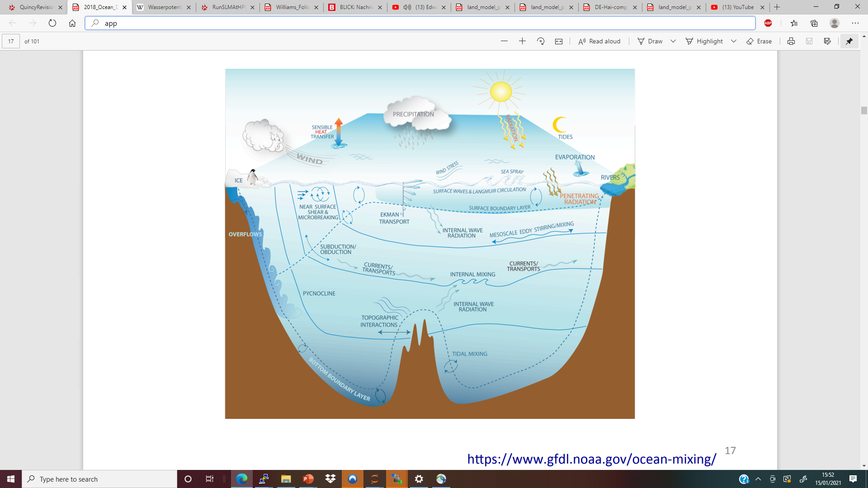
Setting the Scene: Ocean and Ice as Part of the Climate System

Slide 9
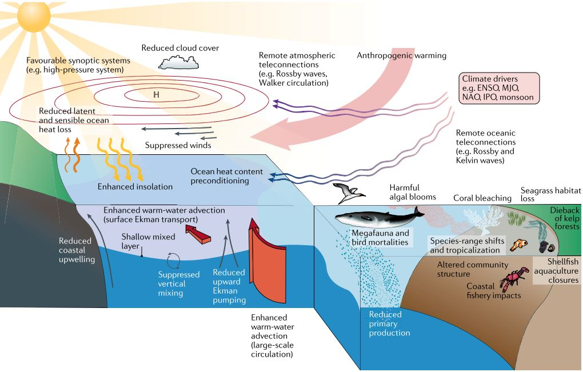
Setting the Scene: Ocean and Ice as Part of the Climate System

Slide 10
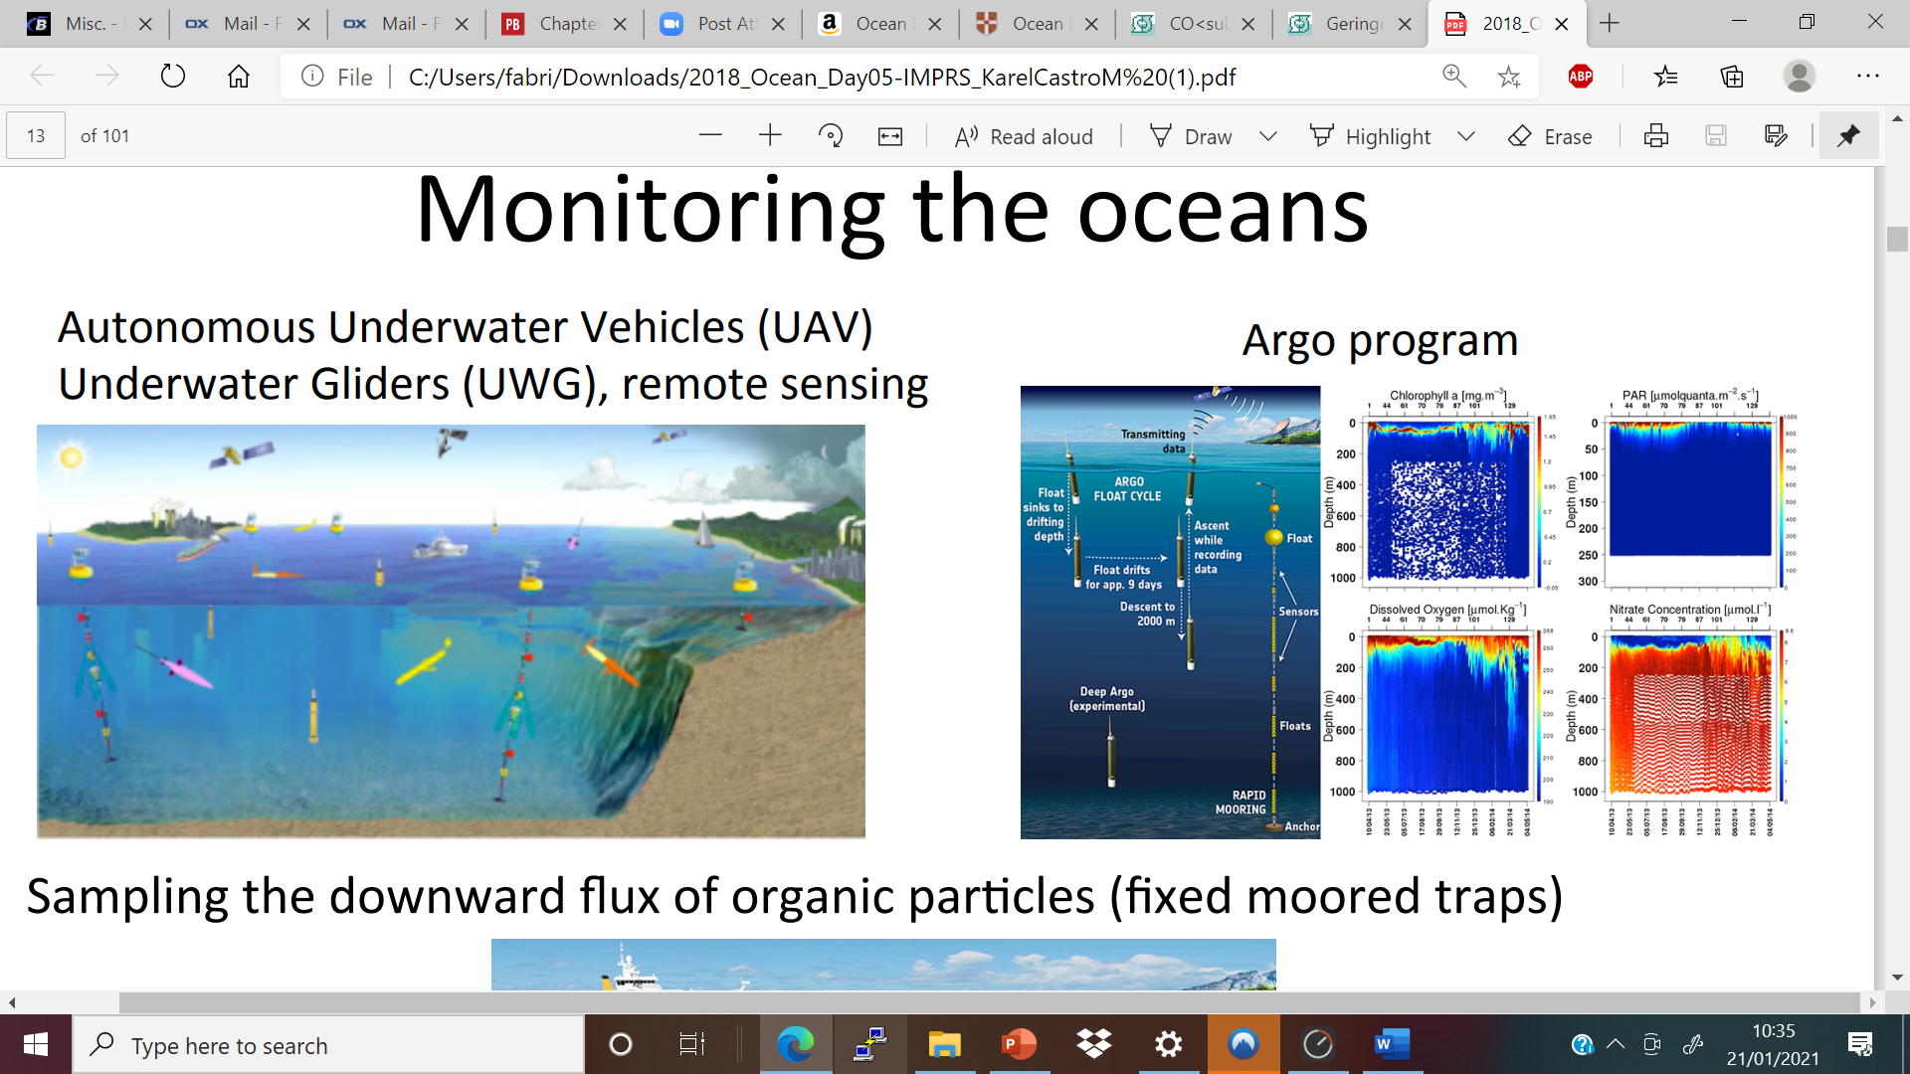
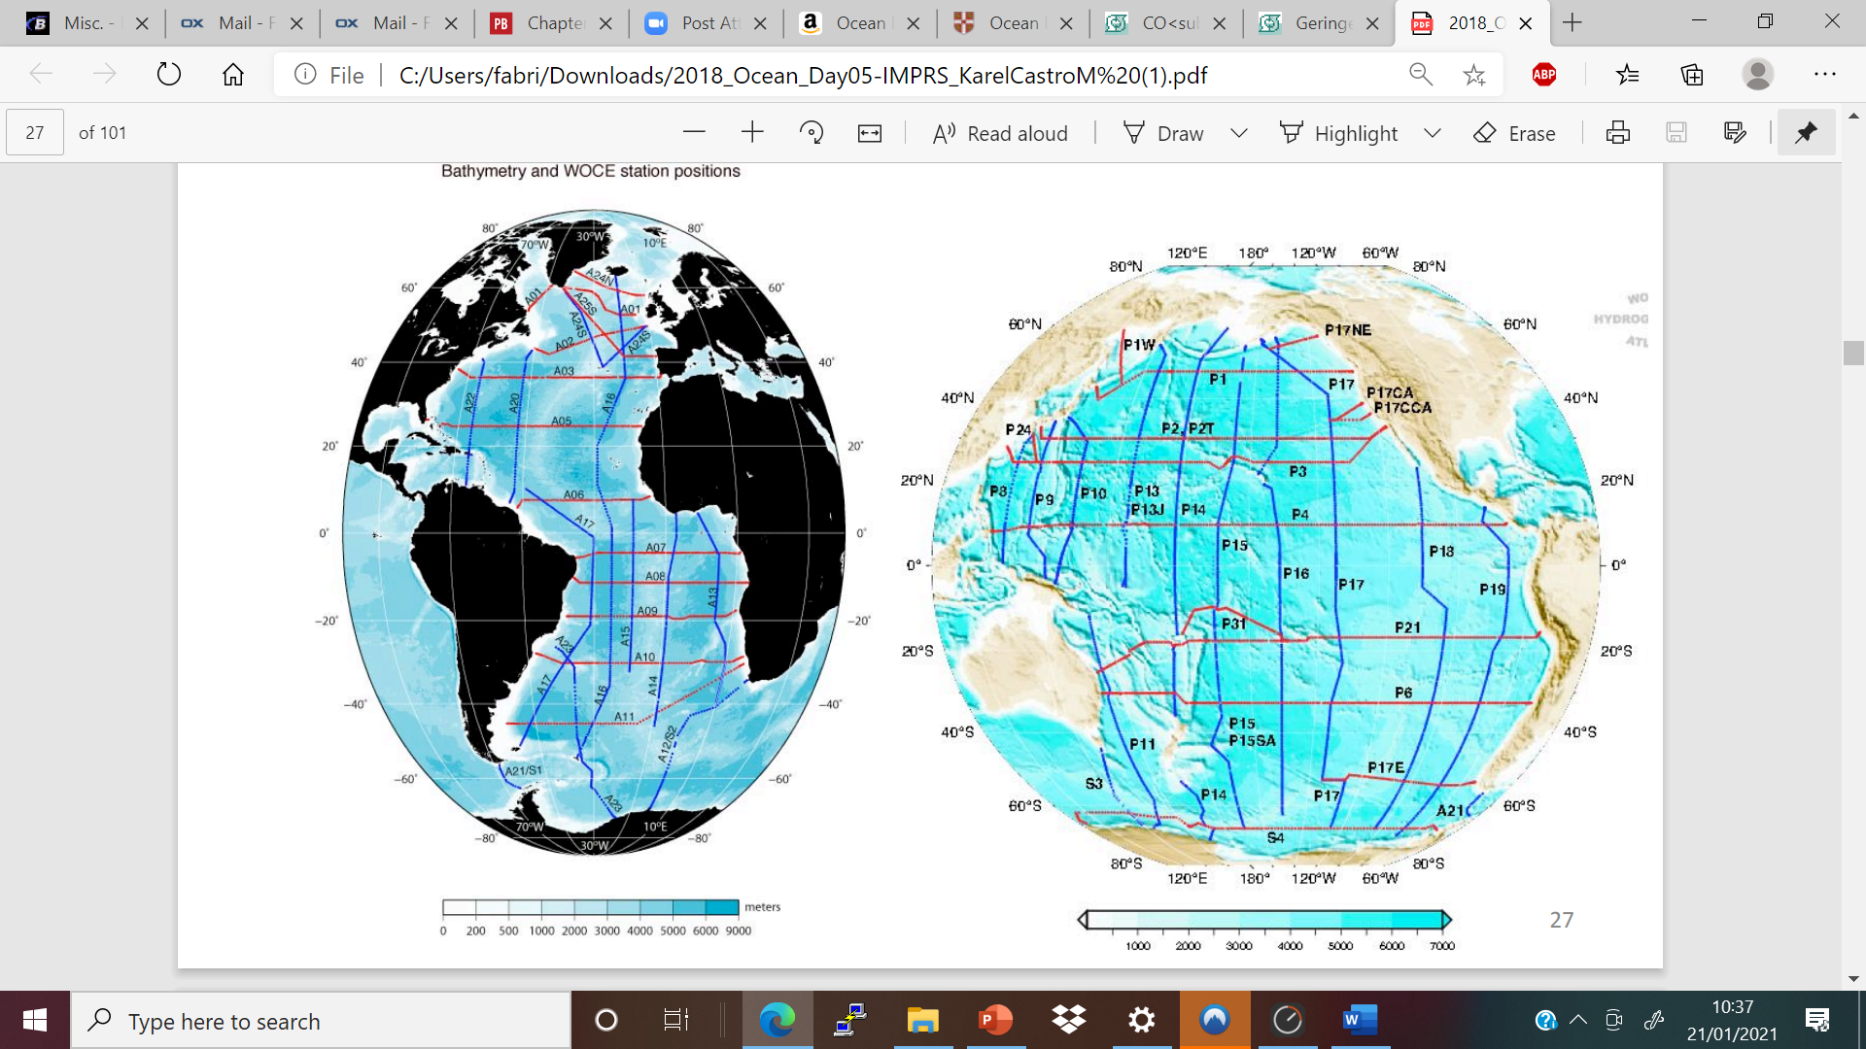
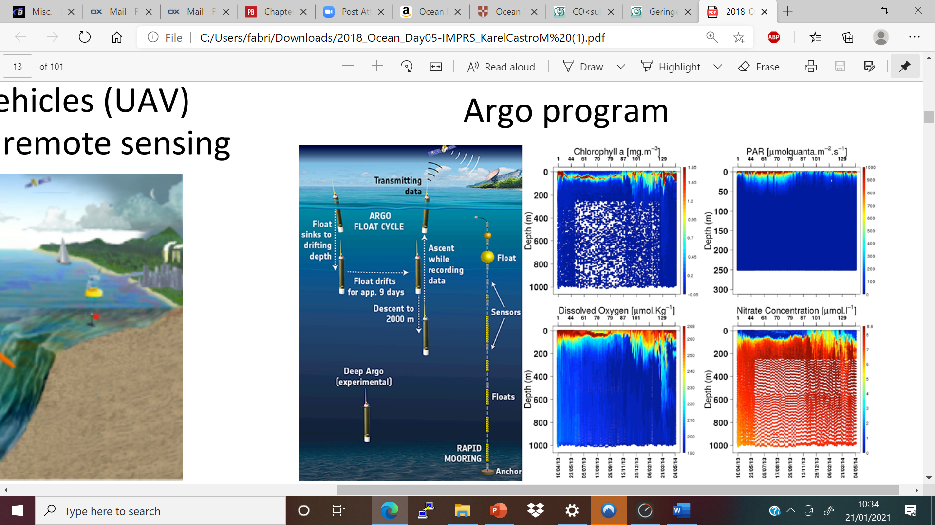
Setting the Scene: Monitoring
World Ocean Atlas

Slide 11
Program
1. Basic Principles of Ocean Circulation
1.1. Time and Spatial Scales in the Ocean
1.2. Ocean Water Properties
1.3. Dynamics of Ocean Circulation
1.4. Ocean Heat Transport
#Break
2. Ocean Carbon Cycle
2.1. Life in the Ocean (Biological Pump)
2.2. Solubility Pump (Carbonate Chemistry)
2.3. Present and Future Carbon Uptake
3. Climate-Ocean Feedbacks
3.1. Climate Oscillations : ENSO
3.2. Marine Feedbacks

Slide 12

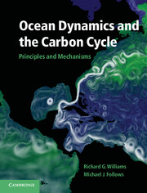
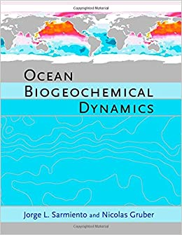
Books
Talley et al. (2011): Descriptive Physical Oceanography
Williams and Follows (2011):Ocean Dynamics and the Carbon Cycle
Sarmiento and Gruber (2005): Ocean Biogeochemical Dynamics

Slide 13
1. Basic Principles of Ocean Circulation

Slide 14
1.1. Time and Spatial Scales in the Ocean

Slide 15
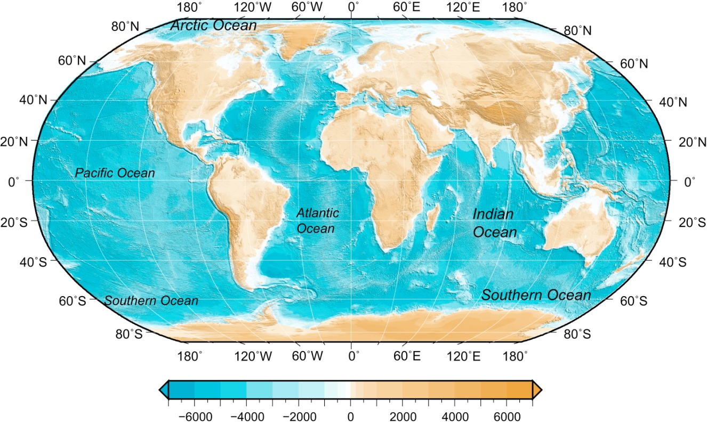
Time- and spatial-scales of ocean circulation
Surface area of 3.61 x 10¹⁴ m² (71 % of Earth’s surface)
Mean depth of around 4000 m
Volume of 3.2 x 10¹⁷ m³

Slide 16
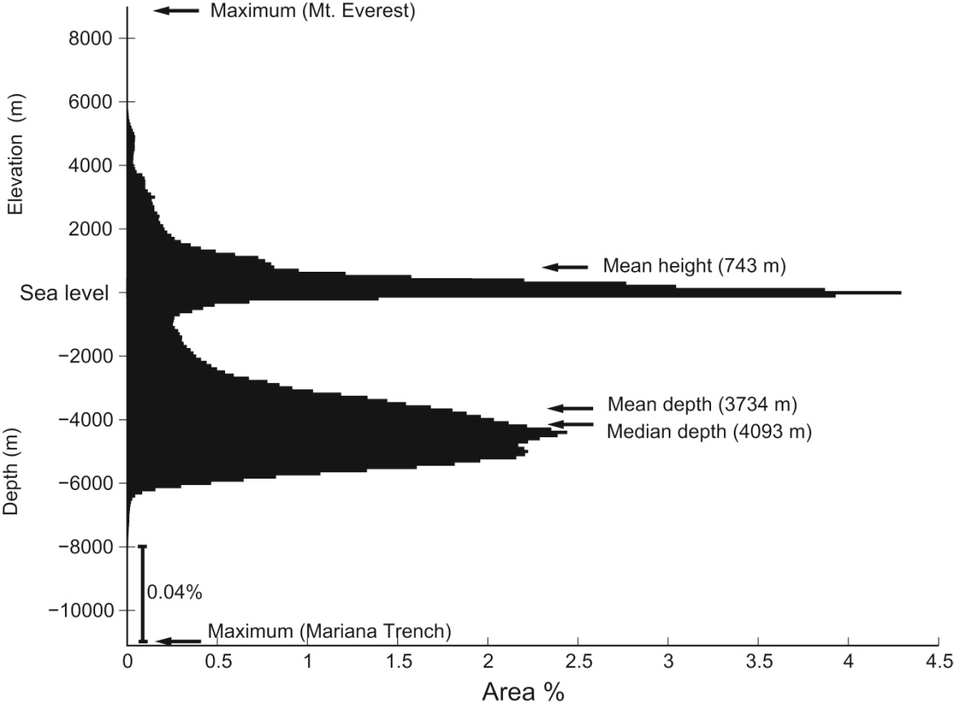
Time- and spatial-scales of ocean circulation
Areas of Earth’s surface above and below sea level as a percentage of the total area of Earth (in 100 m intervals). Data from Becker et al. (2009).
TALLEY Copyright © 2011 Elsevier Inc. All rights reserved

Slide 17
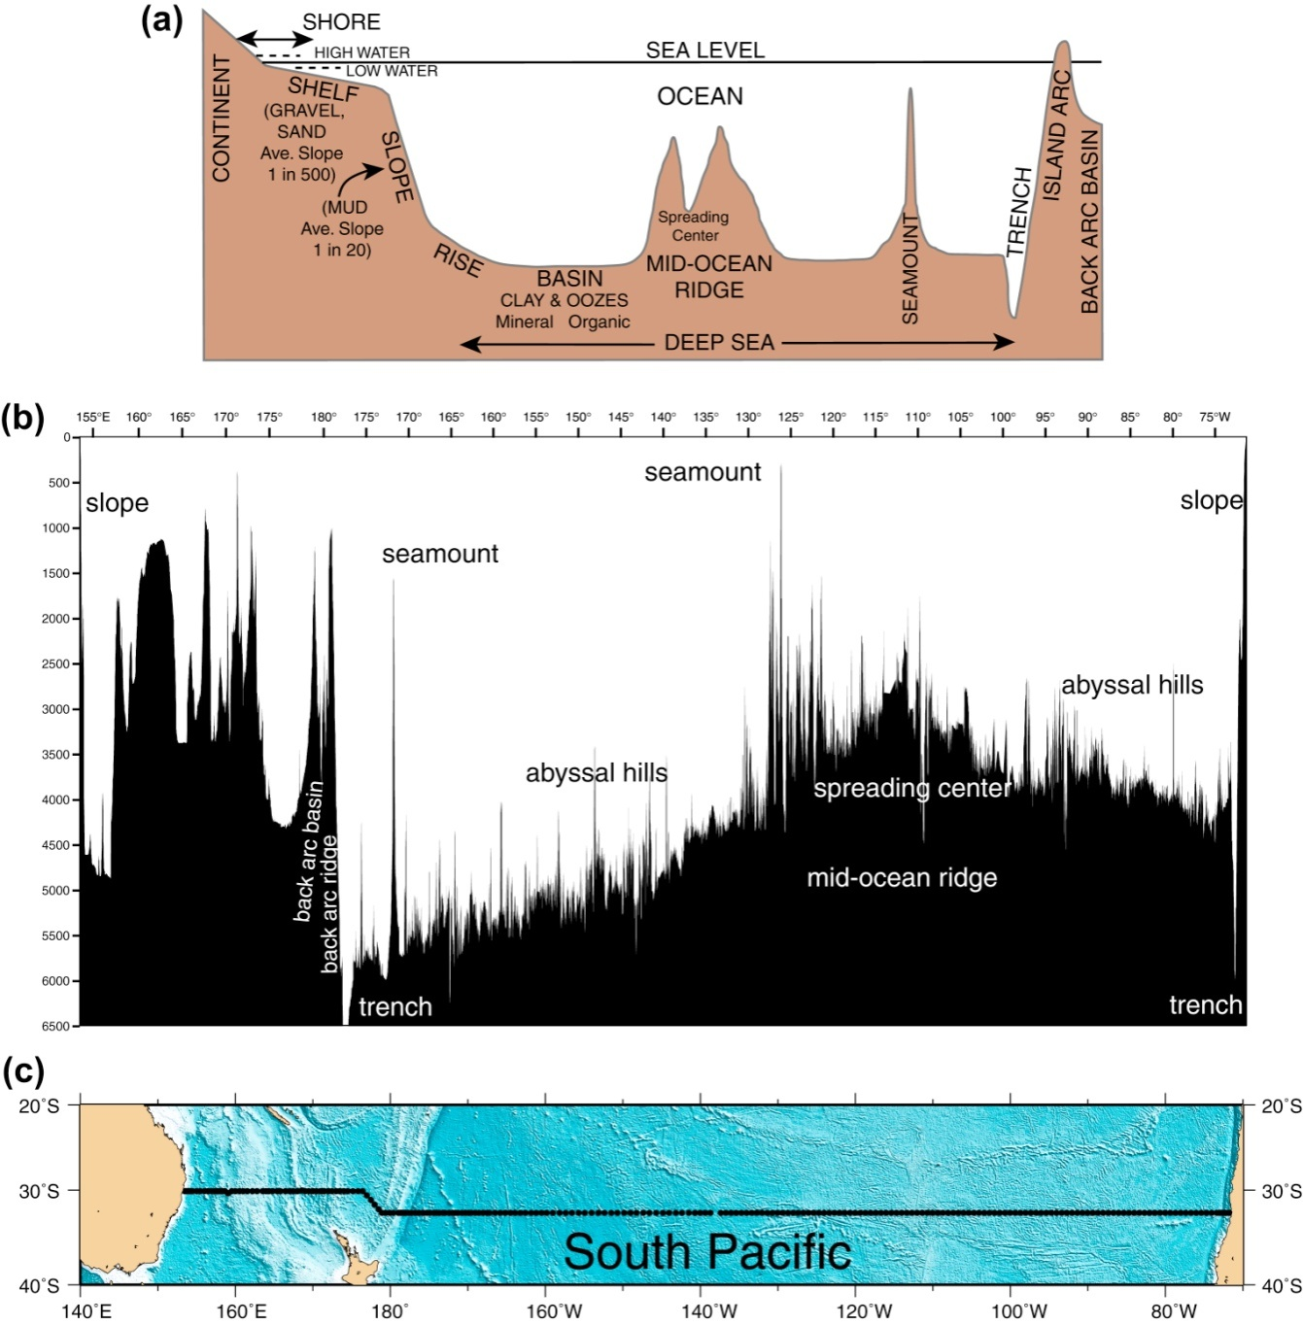
Time- and spatial-scales of ocean circulation

Slide 18
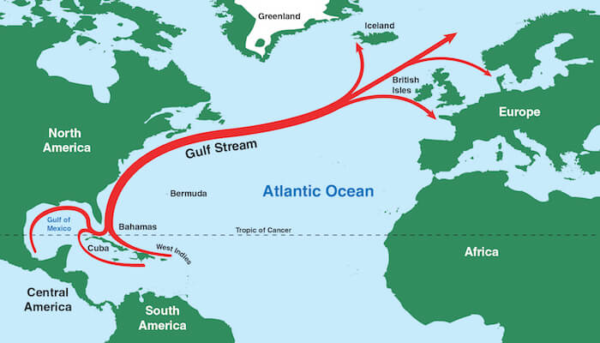
Time- and spatial-scales of ocean circulation
Gulf Stream:
Notes:
Gulf stream, width of around 100km carrying heat accross the ocean for thousands of kms
First map drawn by Benjamin Franklin, after observing that some of his trips were considerably quicker than others 18th century

Slide 19
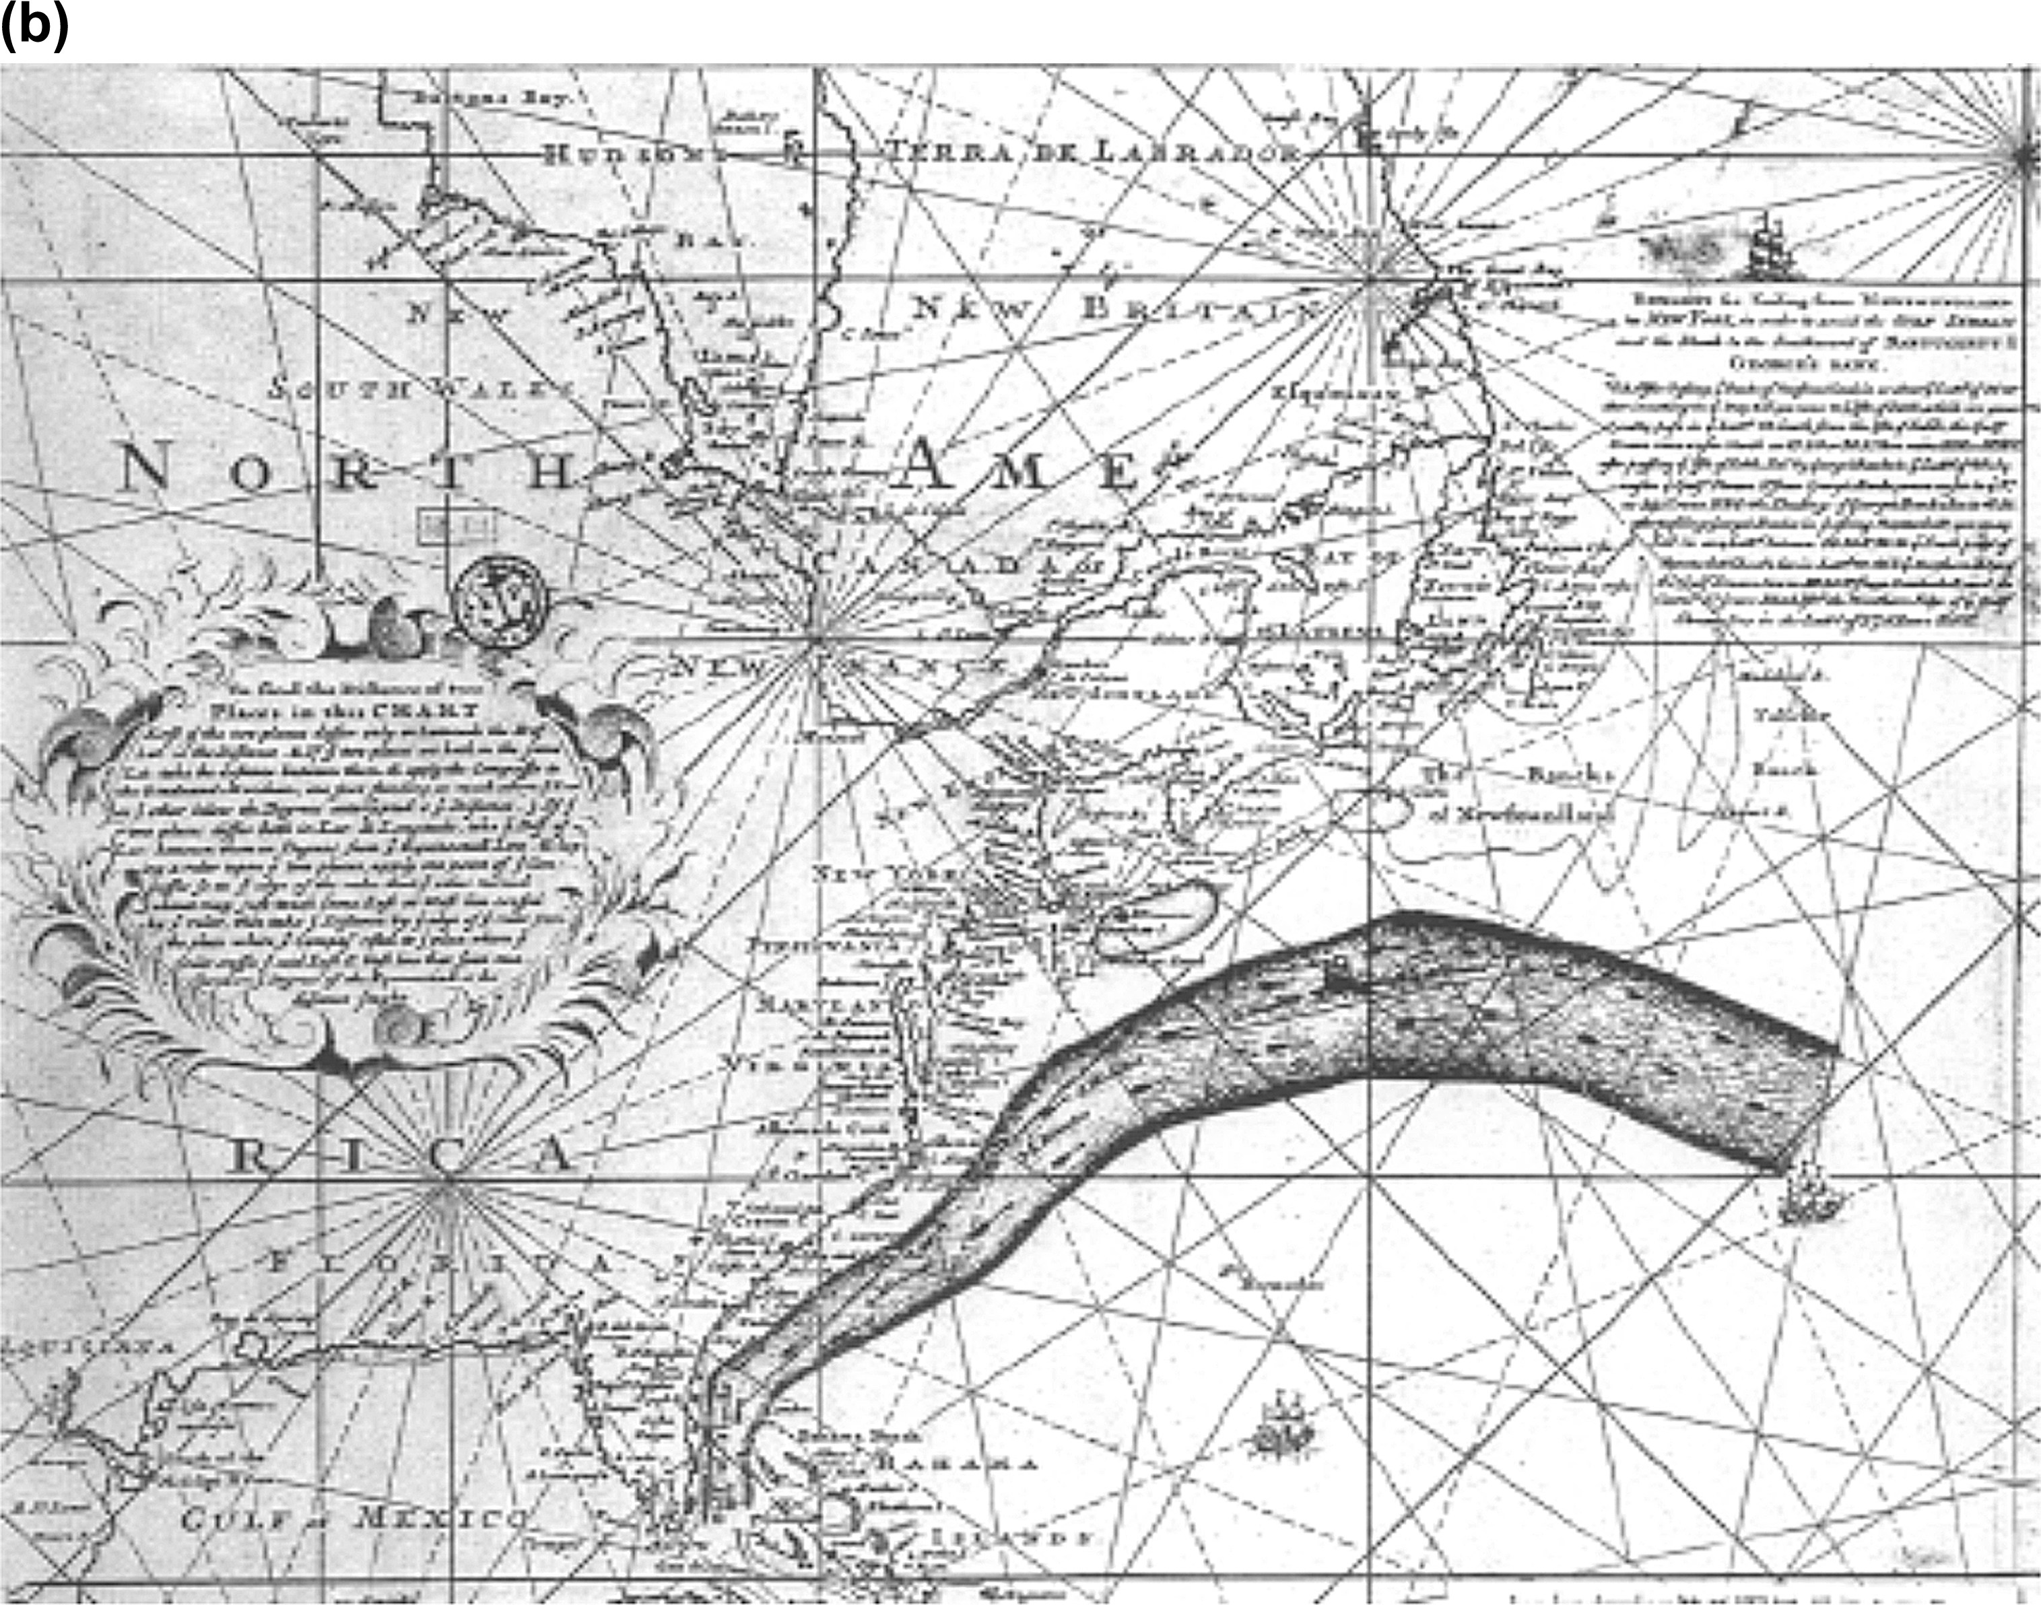
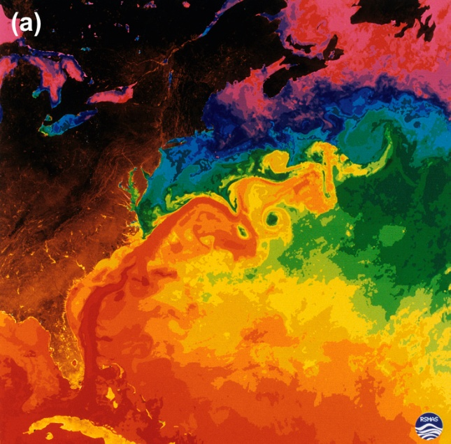
Time- and spatial-scales of ocean circulation
Gulf Stream:
Drawn by Benjamin Franklin, 18th century
Temperature derived from satelite
Notes:
Gulf stream, width of around 100km carrying heat accross the ocean for thousands of kms
First map drawn by Benjamin Franklin, after observing that some of his trips were considerably quicker than others 18th century

Slide 20

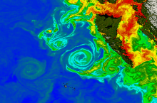
Time- and spatial scales of ocean circulation
Storm surge, eddies, waves
-> Temporary feature

Slide 21
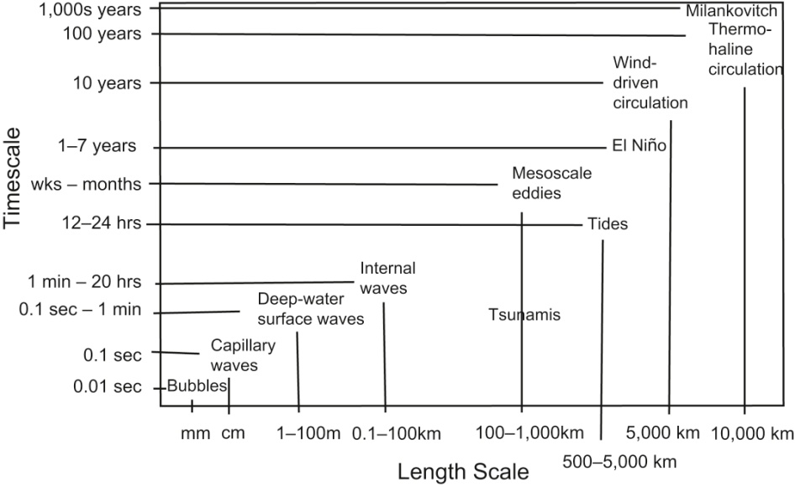
Time- and spatial scales of ocean circulation

Slide 22
Ocean properties that impact ocean dynamics

Slide 23
Ocean Water Properties

Slide 24
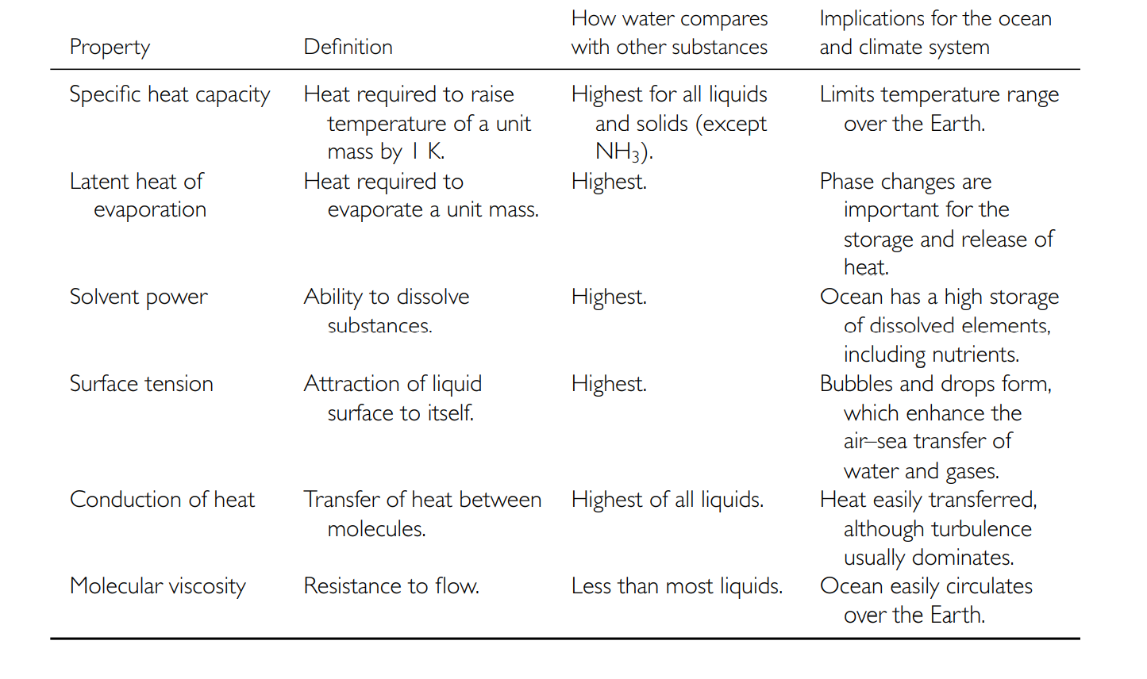
Water properties

Slide 25
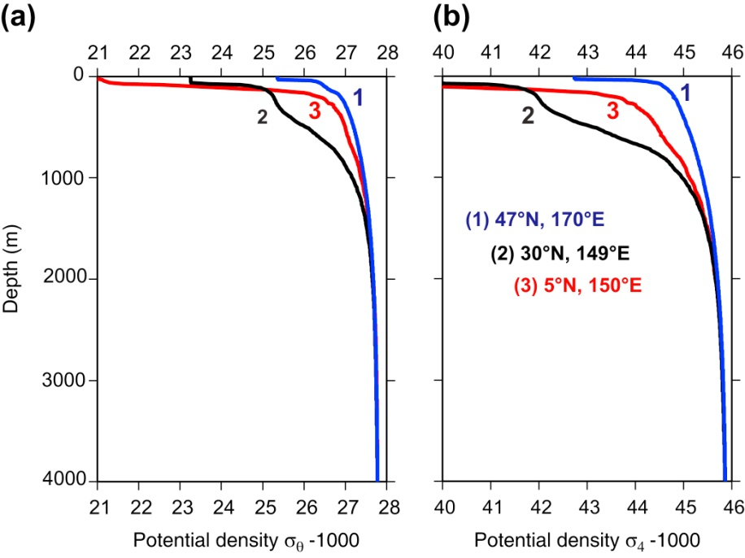
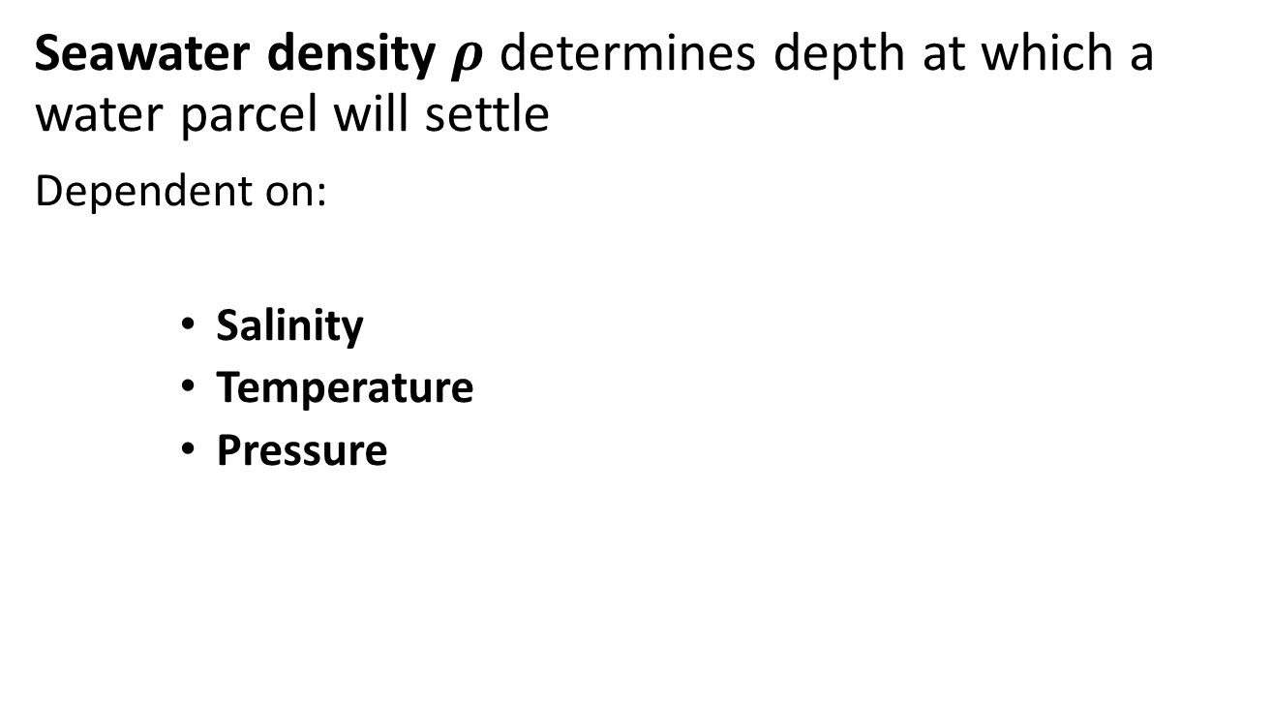
Water Properties: Density
Seawater density $ρ$ determines depth at which a water parcel will settle
Dependent on:
Salinity
Temperature
Pressure
Typical density/depth profiles in the North Pacific.

Slide 26
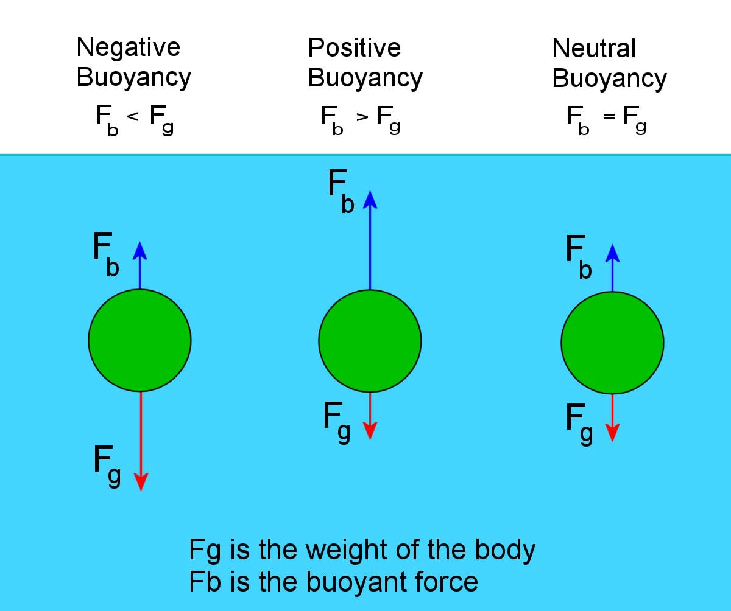
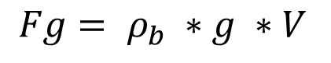
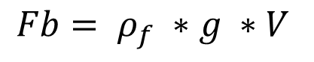
Water properties: buoyancy
Buoyancy determines whether a water parcel will rise or sink
Buoyancy force
$$Fb= ρ_{f} ∗g ∗V$$
Gravitation
$$Fg= ρ_{b} ∗g ∗V$$

Slide 27
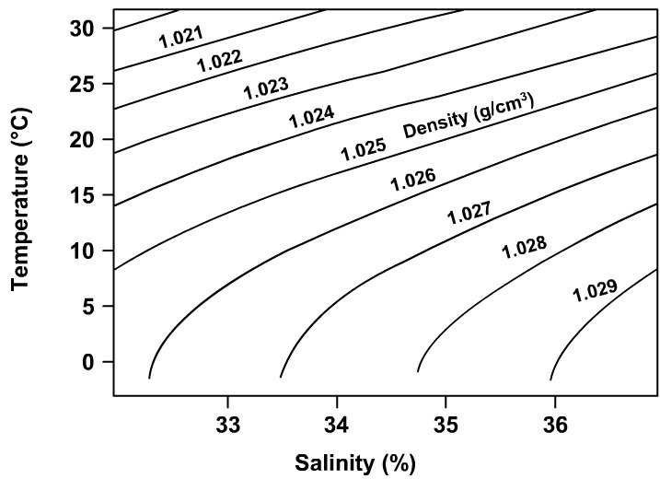
Water Properties: Density
Salinity and Temperature Effect
Negative effect of temperature
Positive effect of salinity

Slide 28
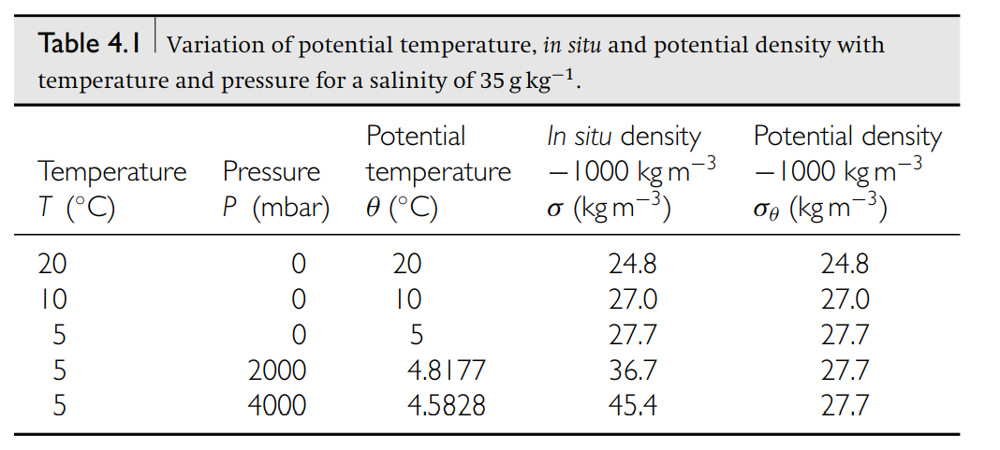
Water Properties: Potential density
Potential temperature density:
Adjustment to compare density of water parcels at different depth/pressure

Slide 29
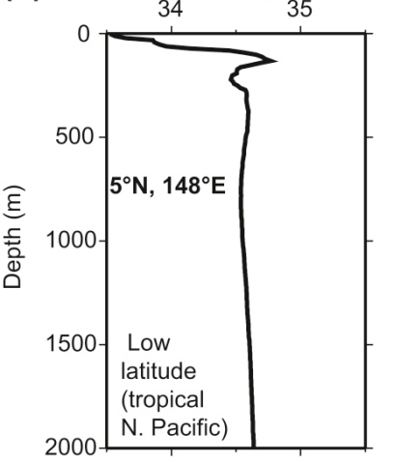
Distribution of water properties
Vertical:
Salinity
Potential temperature
Potential density
Notes:
Radiative heat uptake and precipitation at the surface causes vertical stratification

Slide 30
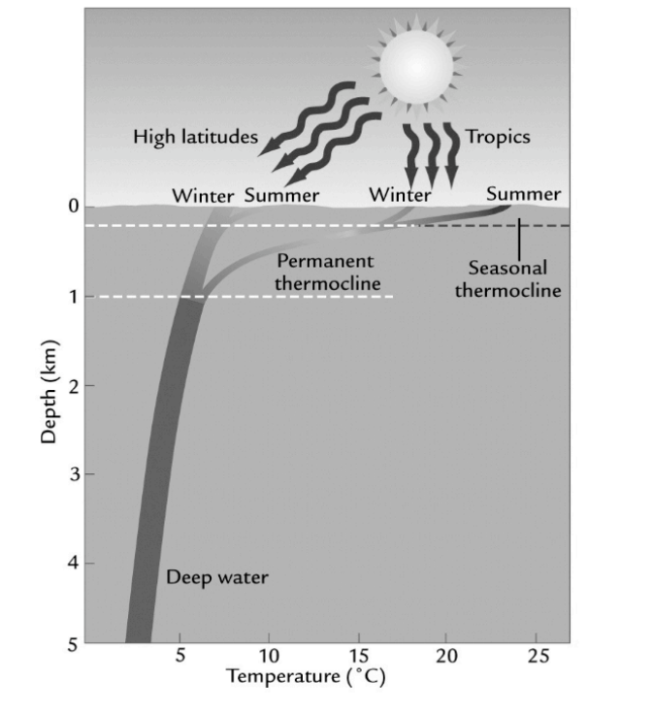
Distribution of water properties
Vertical: Thermocline
Pot. temperature

Slide 31
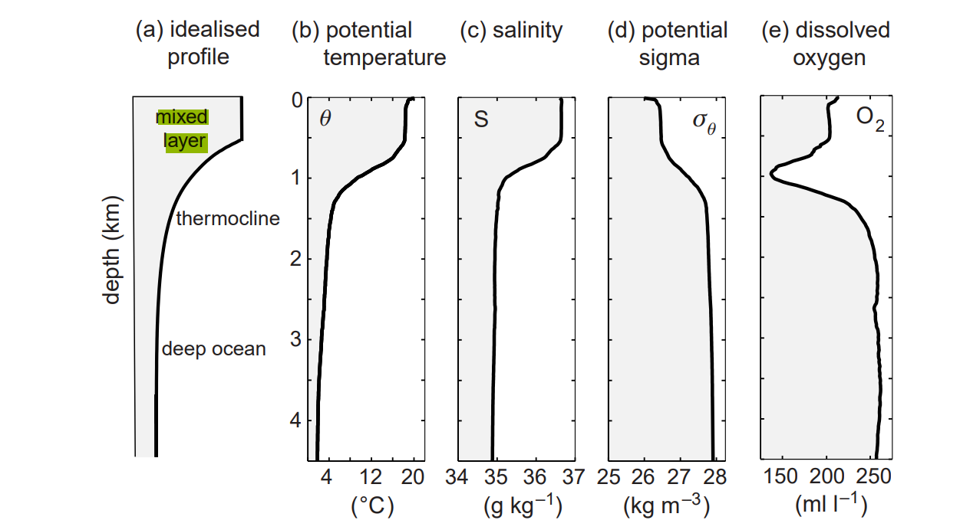
Distribution of water properties
Vertical
Mixed layer depth for biological processes and carbon dynamics

Slide 32
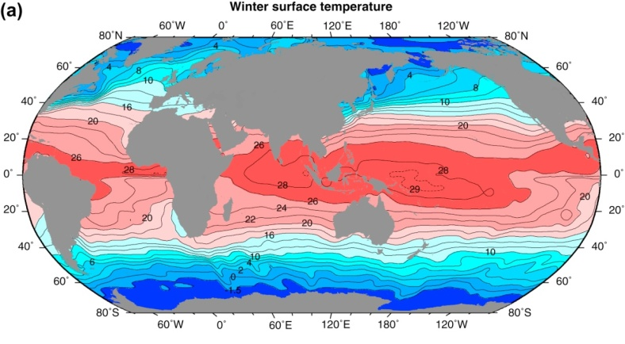
Distribution of water properties
Horizontal distribution: temperature
High temperature in the tropics, decreasing pol-wards

Slide 33
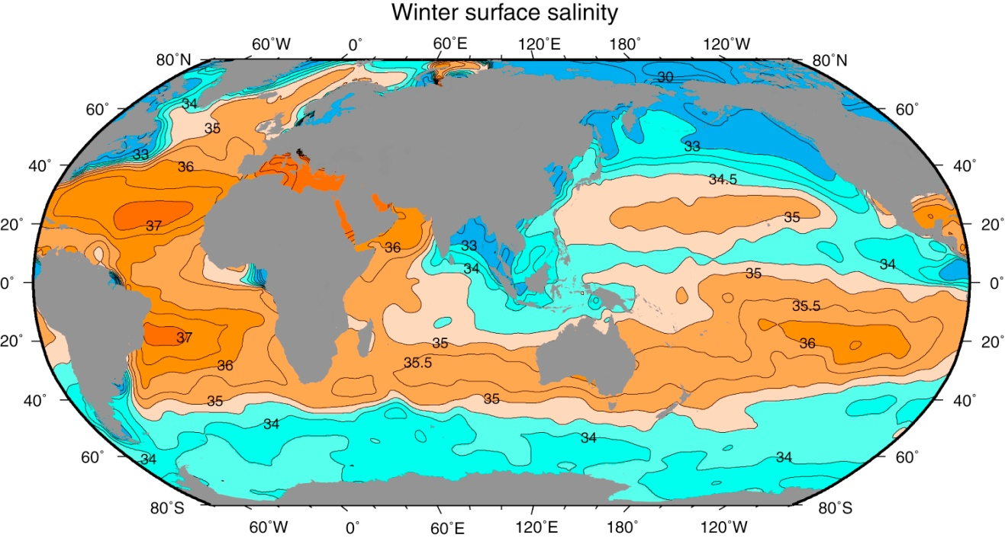
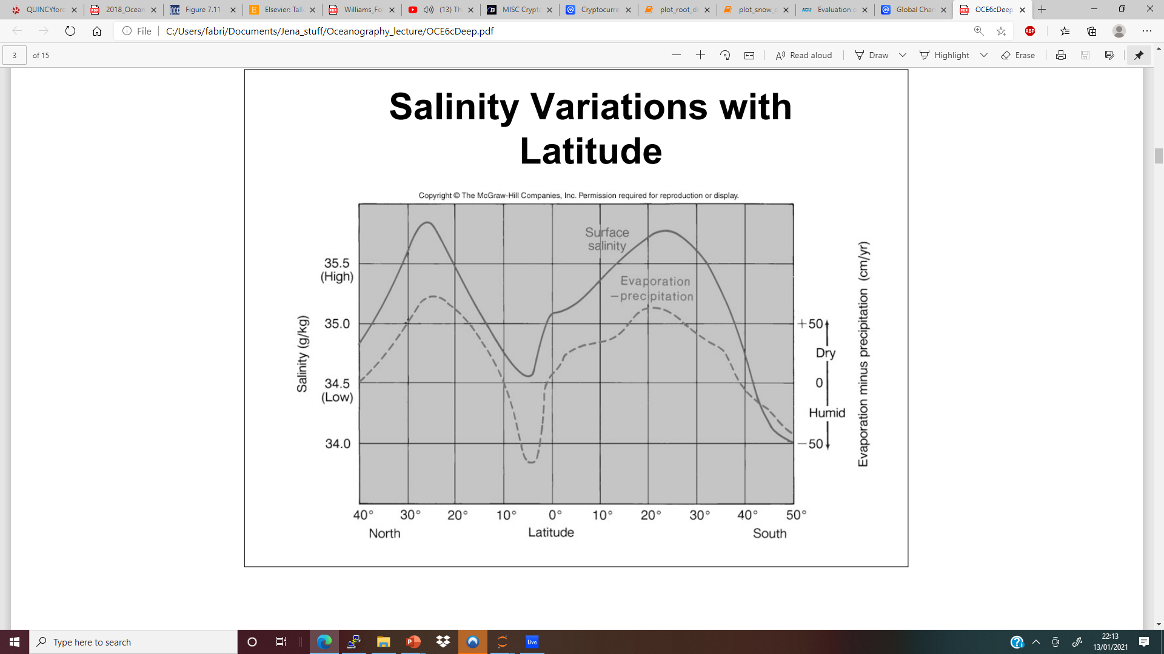
Distribution of water properties
Horizontal distribution: Salinity
Low salinity in the tropics, increasing pol-wards
Surface salinity (psu) in winter (January, February, and March north of the equator; July, August, and September south of the equator) based on averaged (climatological) data from Levitus et al. (1994b). From Talley (2011)

Slide 34
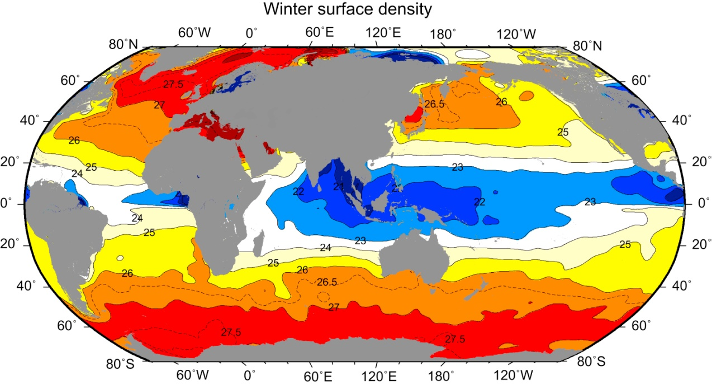
Distribution of water properties
Horizontal distribution: Density
Low density in the tropics, increasing pol-wards
Surface density σ_{θ} (kg m^{–3}) in winter (January, February, and March north of the equator; July,
August, and September south of the equator) based on averaged (climatological) data from Levitus
and Boyer (1994) and Levitus et al. (1994b).

Slide 35
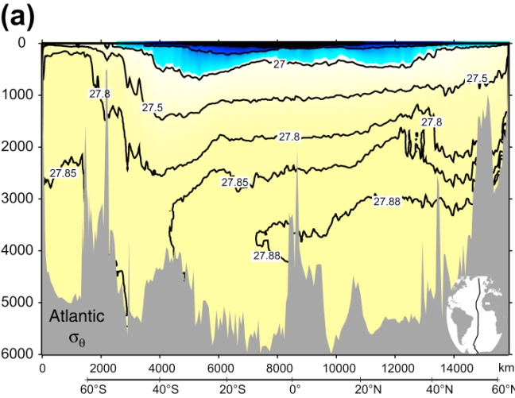
Distribution of water properties
Ocean Interior density

Slide 36
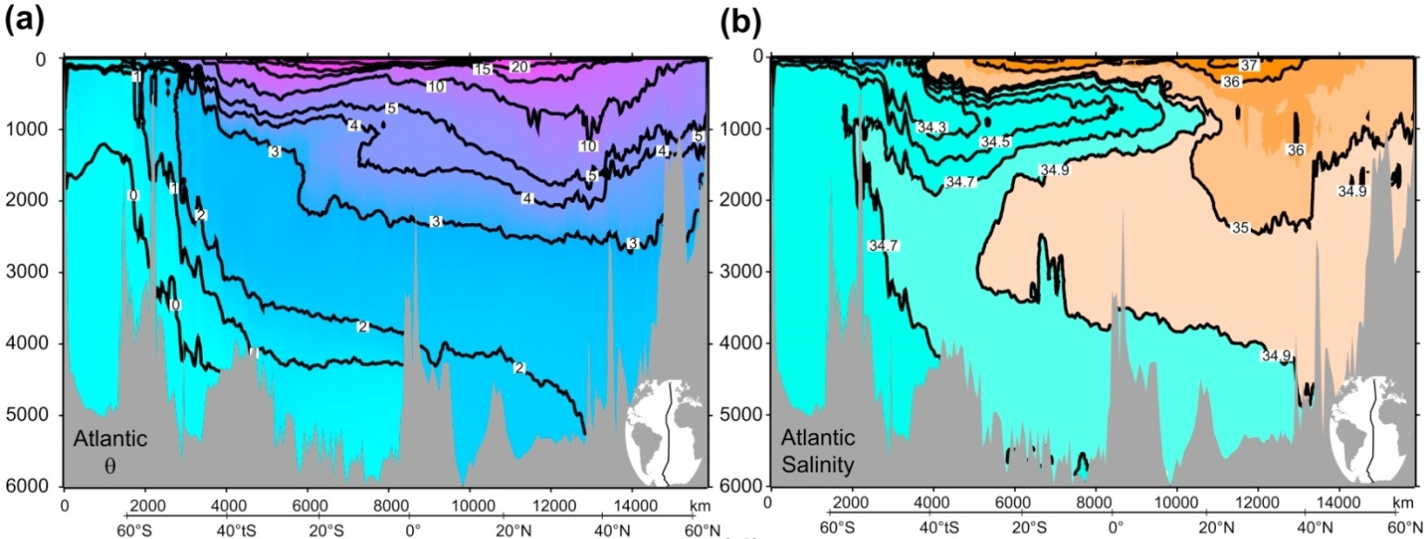
Distribution of water properties
Ocean Interior: temperature and salinity
TALLEY Copyright © 2011 Elsevier Inc. All rights reserved

Slide 37
Dynamics of Ocean Circulation

Slide 38
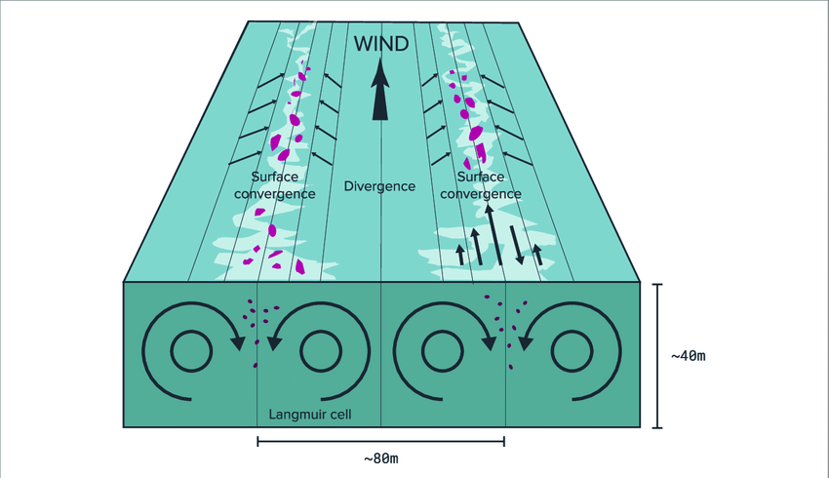
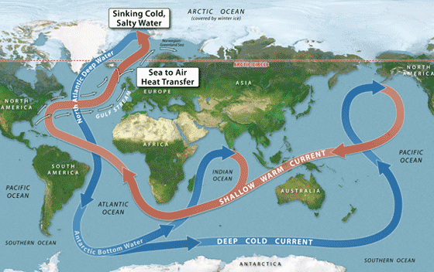
Ocean Circulation
Wind-driven surface (-> Surface Ocean)
Waves, inertial currents, Langmuir cells
Thermohaline circulation (-> Deep Ocean, Overturning)
Notes:
The ocean circulates, redistributing heat, carbon and tracers over the globe. Ocean currents are mainly driven by the frictional drag from the wind blowing over the sea and the air–sea exchange of heat and fresh water. While this forcing is comparatively easy to understand, the ocean’s response is more complex

Slide 39
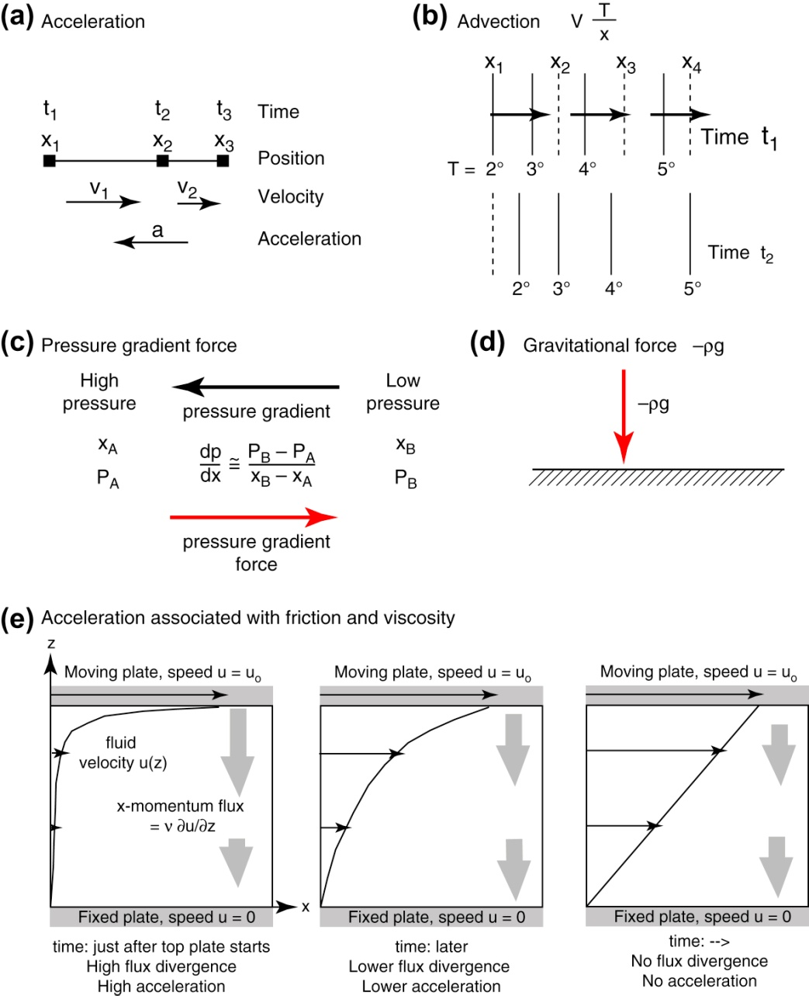
Ocean Circulation
Momentum Balance
Density * (Acceleration + Advection) = Pressure Gradient Force + Gravity + Friction
Forces and accelerations in a fluid: (a) acceleration, (b) advection, (c) pressure gradient force, (d) gravity, and (e) acceleration associated with viscosity υ.
TALLEY Copyright © 2011 Elsevier Inc. All rights reserved

Slide 40
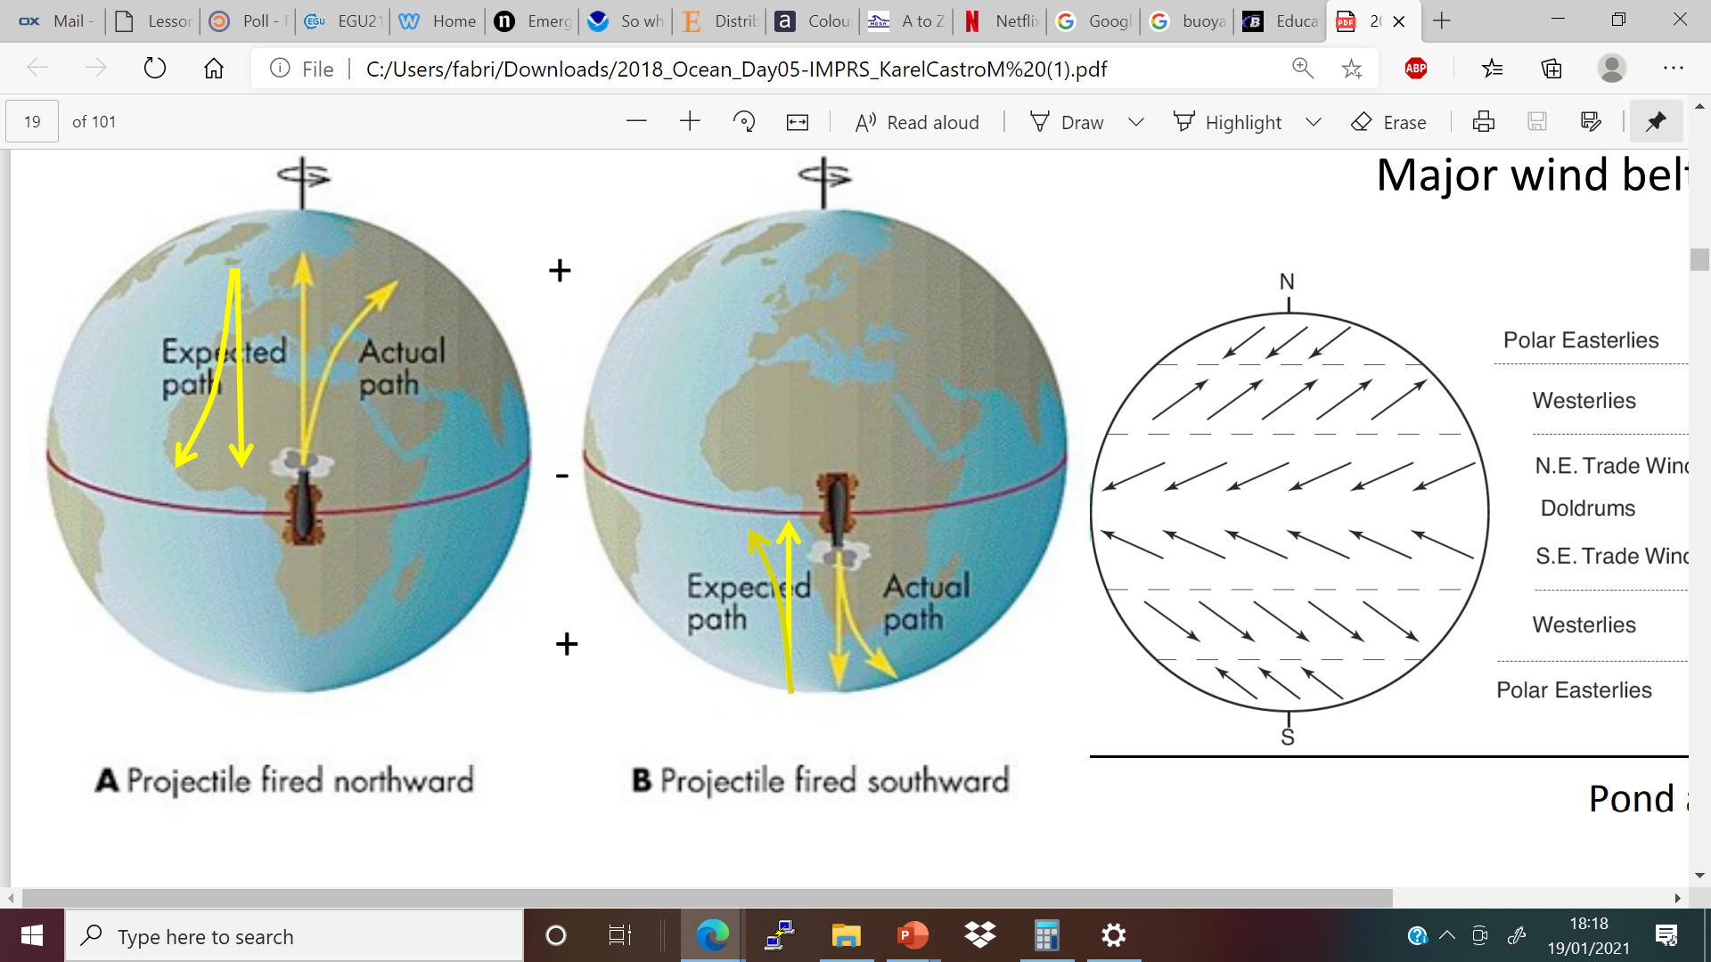
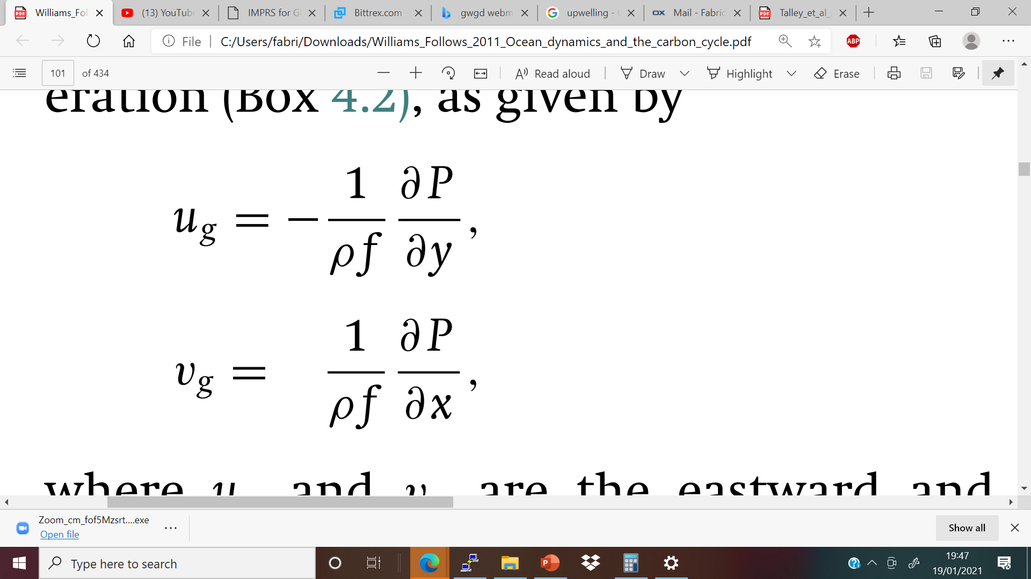
Coriolis force
Geostrophic velocity considering Coriolis and pressure gradient
f: coriolis parameter
Increases with latitude (!)

Slide 41
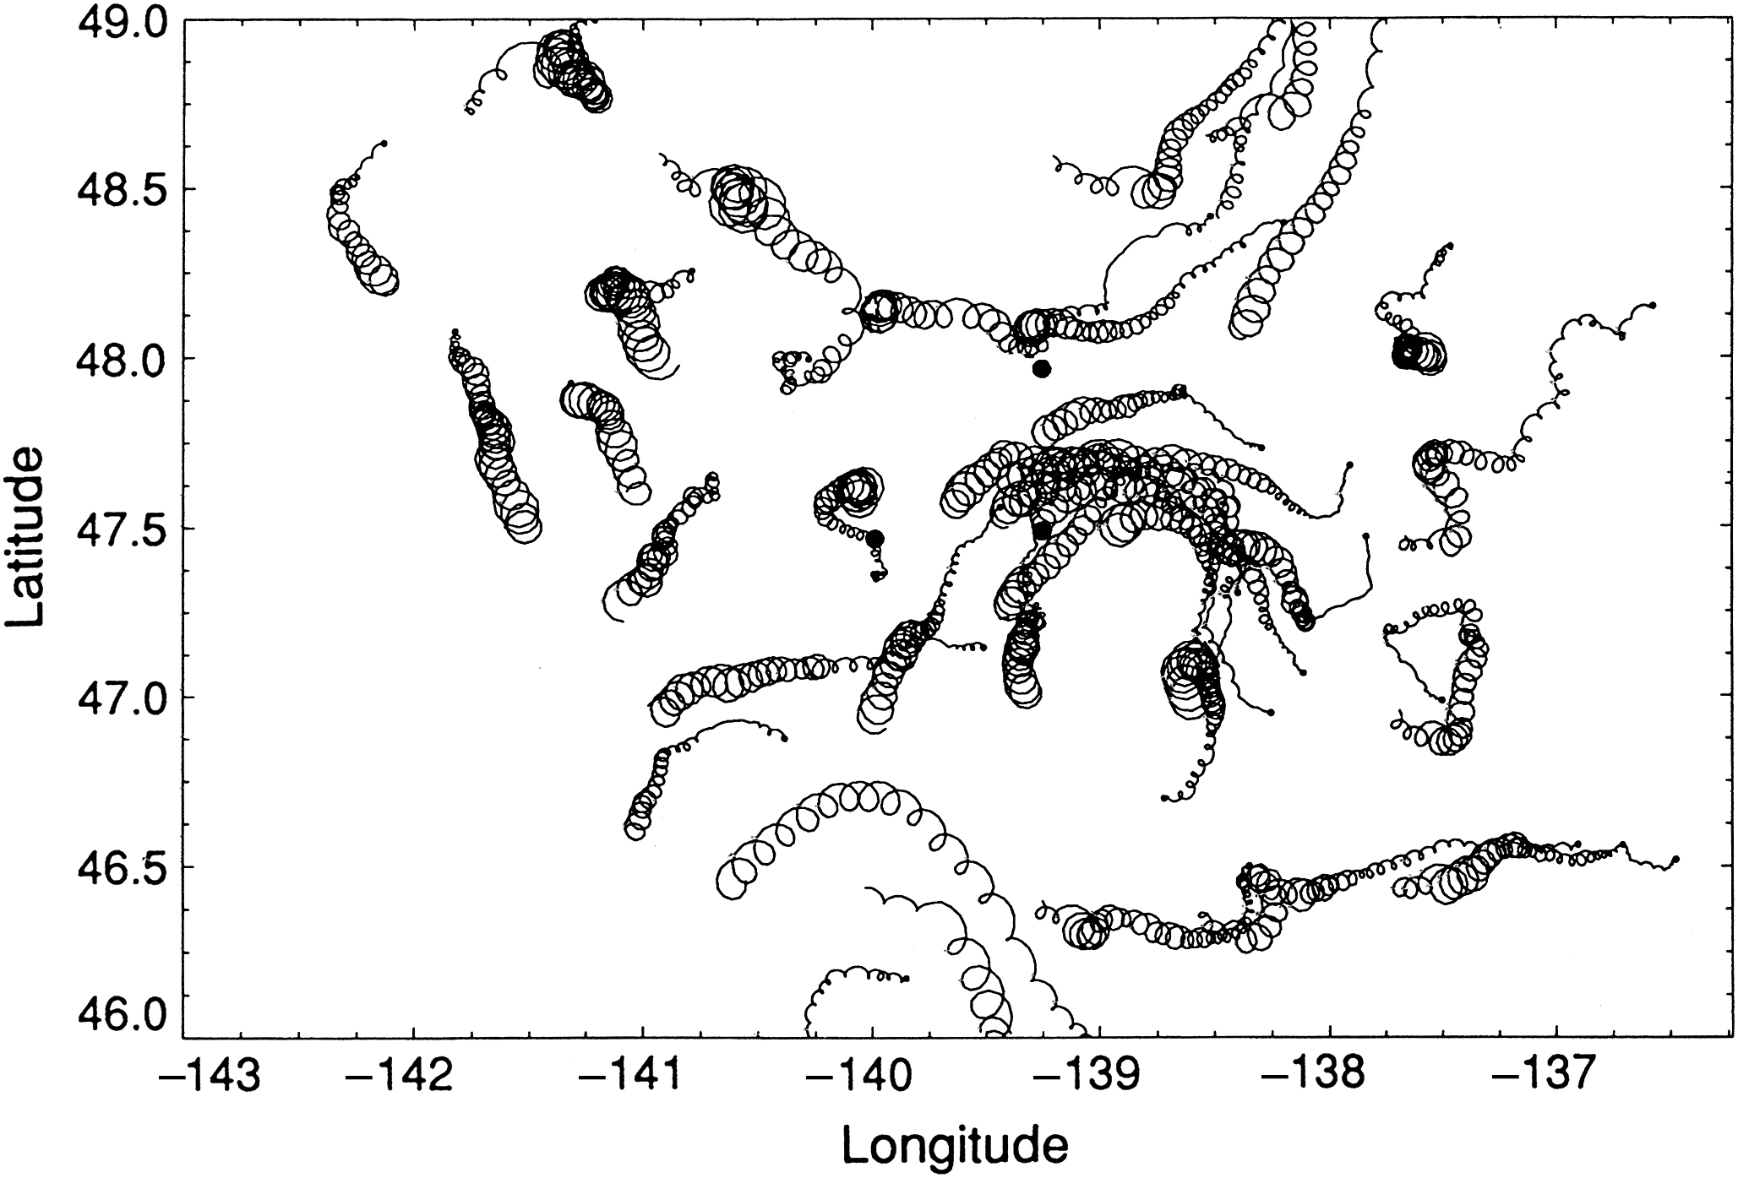
Ocean Circulation
Wind-driven circulation: Inertial
Wind causes surface stress up to around 50m
First causes motion due to stress in direction of the wind and Coriolis
Observations of near-inertial currents. Surface drifter tracks during and after a storm. ©American Meteorological Society. Reprinted with permission. Source: From d’Asaro et al. (1995). See Figure S7.8 for schematics of inertial currents and Ekman’s (1905) original hodograph.
TALLEY Copyright © 2011 Elsevier Inc. All rights reserved

Slide 42
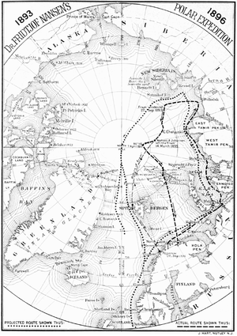
Ocean Circulation
Wind-driven circulation: Ekman
Why icebergs move around 40° to the right of the wind direction? (Friedtjof Nansen, “Fram” 1893)
Wind stress (friction)
Coriolis

Slide 43
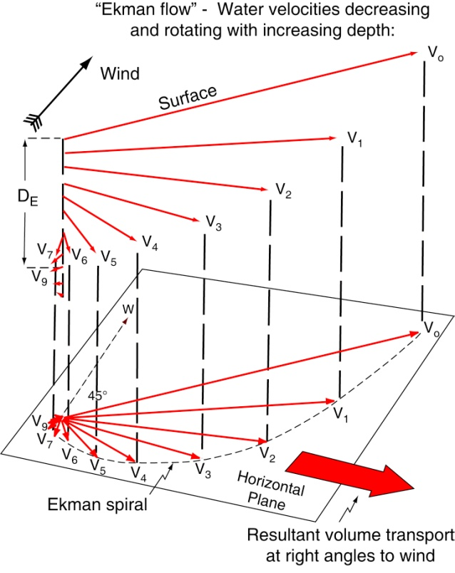
Ocean Circulation
Wind-driven circulation: Ekman
Why icebergs move 20-40° to the right of the wind direction? (F. Nansen, “Fram” 1893)
Ekmann flow is a combination of wind stress and coriolis
TALLEY Copyright © 2011 Elsevier Inc. All rights reserved

Slide 44
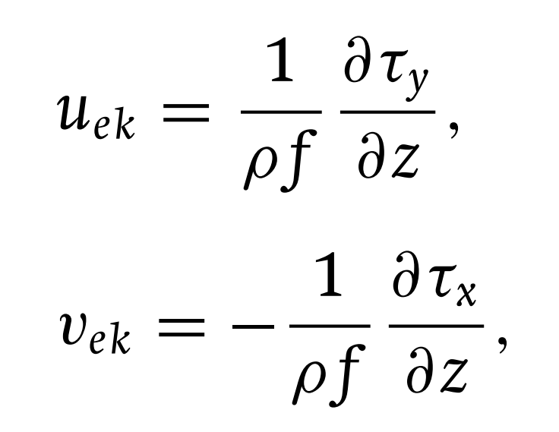
Ocean Circulation
Wind-driven circulation: Ekman
Why icebergs move 20-40° to the right of the wind direction? (F. Nansen, “Fram” 1893)
Ageostrophic (Eckman) velocity:
Ekmann flow is a combination of wind stress and coriolis
Τx, τy: frictional and turbulent stresses acting within the water column (N m⁻²)
Mean flow at 90 degrees angle
To the right for Northern Hemisphere
To the left for Southern Hemisphere
TALLEY Copyright © 2011 Elsevier Inc. All rights reserved

Slide 45
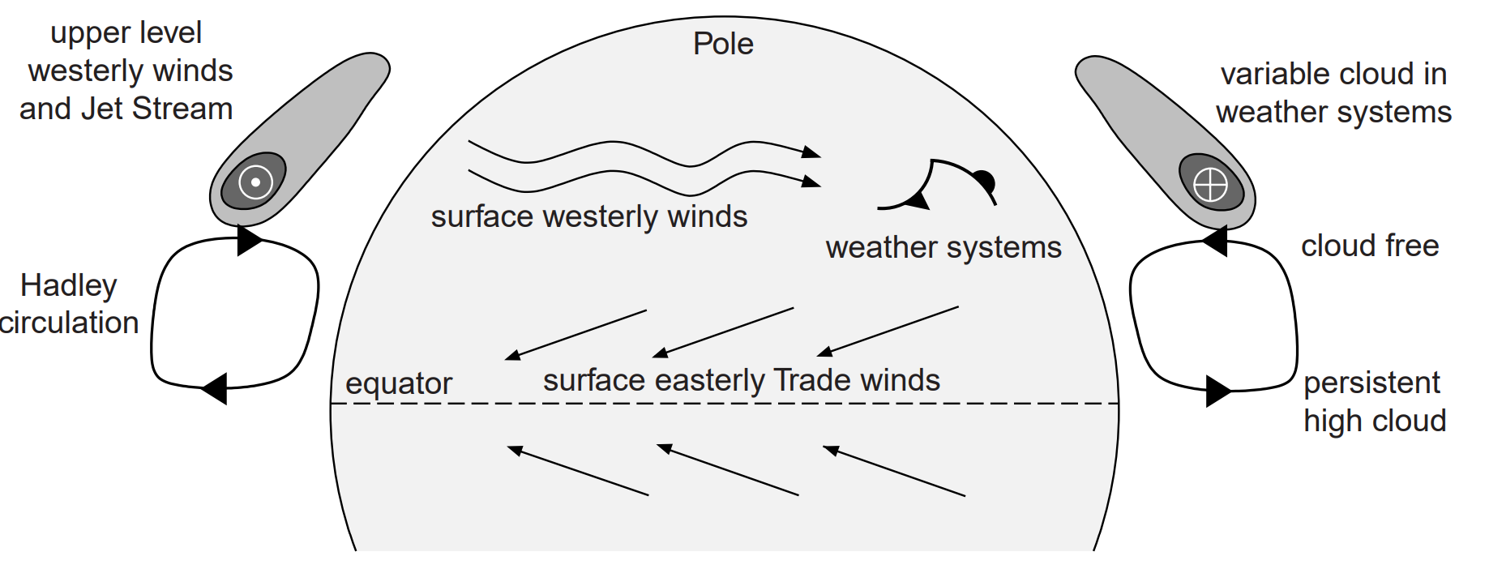
Ocean Circulation
Global wind pattern sketch

Slide 46
Ocean Circulation
Global wind pattern sketch

Slide 47
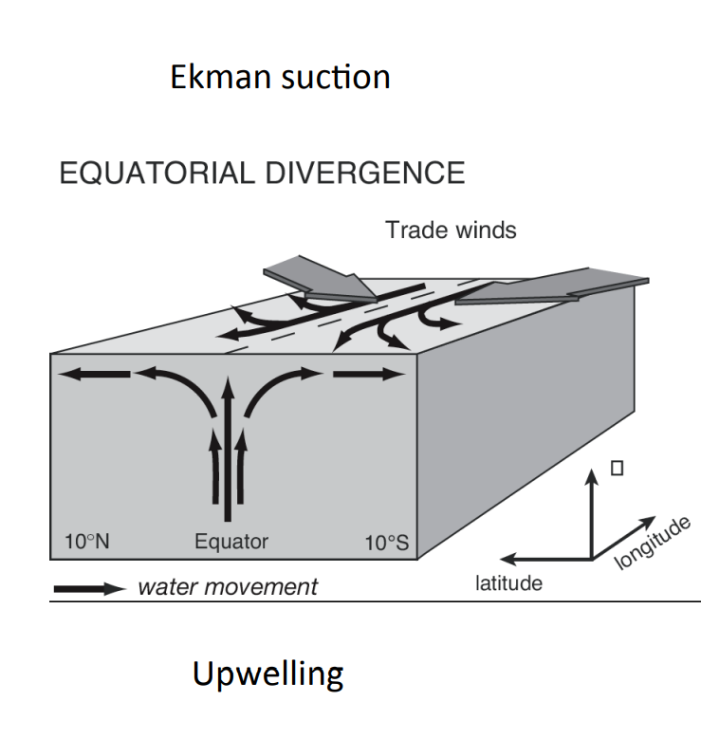
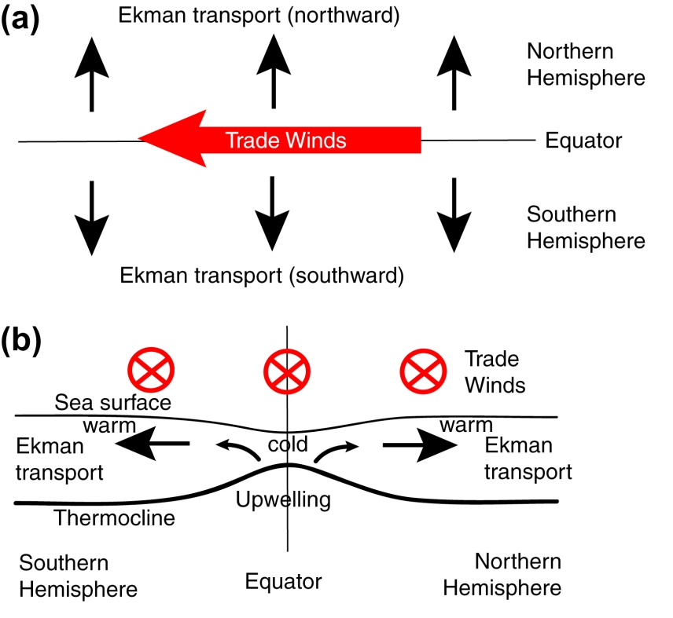
Ocean Circulation
Equatorial Upwelling
-> Upwards current of cold water from deep ocean layers to the surface
TALLEY Copyright © 2011 Elsevier Inc. All rights reserved

Slide 48
Ocean Circulation
Global wind pattern sketch

Slide 49
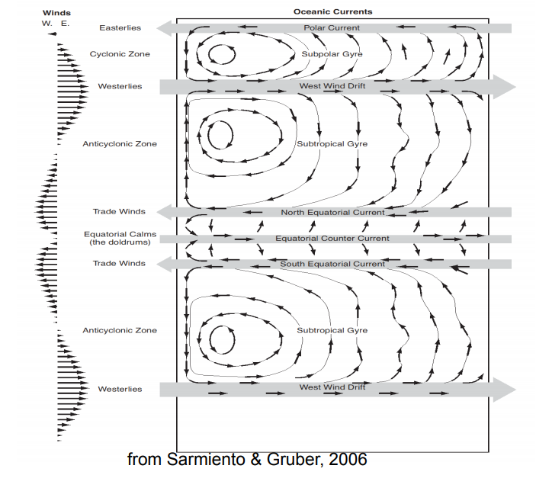

Ocean Circulation
Wind-driven circulation

Slide 50

Ocean Circulation and Currents
Warm Western Boundary Currents
Cold Eastern Boundary Currents

Slide 51

Ocean Circulation
Eckman: Coastal upwelling
Nutrient, DIC rich

Slide 52

Ocean Circulation
Wind-driven circulation: Upwelling

Slide 53

Ocean Circulation
Thermohaline circulation: Density-driven

Slide 54

Ocean Circulation
Thermohaline circulation: density-driven
When water is cooled, it becomes denser, causing a loss in buoyancy
Buoyancy is also lost when evaporation exceeds precipitation
This creates convection of water, often found in the higher latitude

Slide 55

Ocean Circulation
Thermohaline circulation: North Atlantic

Slide 56

Ocean Circulation and Currents
Thermo-haline: simplified
TALLEY

Slide 57

Ocean Circulation and Currents
Thermo-haline including Southern Ocean

Slide 58


Southern Ocean

Slide 59

Southern Ocean
Atlantic Profile

Slide 60


Thermohaline Circulation

Slide 61
Ocean Circulation
NASA | Perpetual Ocean - YouTube

Slide 62
Estimate the northward velocity in the Gulf Stream along the western boundary from the west–east density gradient at 36◦N using
Northward velocity: vg ∼ − g ρ f ρ x z
density ρ ∼ −1 kg m−3
east–west distance x ∼ 100 km
a depth change z ∼ 1 km
f ∼ 10−4 s−1

Slide 63
Oceanic Heat Transport

Slide 64
Ocean Heat uptake

Slide 65

Heat content
Heat Content of water:
$$Q={ρ C}_{p}T$$
C_{p}: Specific Heat Capacity
This high C_{p} is important for temperature buffer effect
Heat sources/sinks are shortwave/longwave radation, latent heat, sensible heat

Slide 66

Heat: Surface temperature
Heat input through the sea surface (where 1 PW = 10¹⁵ W) (world ocean) for 1º latitude bands for all components of heat flux. Data are from the NOCS climatology (Grist and Josey, 2003).
Positive balance
Negative Balance
TALLEY Copyright © 2011 Elsevier Inc. All rights reserved

Slide 67

Heat flux
Annual average net heat flux (W/m²). Positive: heat gain by the sea. Negative: heat loss by the sea. Data are from the NOCS climatology (Grist and Josey, 2003). Superimposed numbers and arrows are the meridional heat transports (PW) calculated from ocean velocities and temperatures, based on Bryden and Imawaki (2001) and Talley (2003). Positive transports are northward.

Slide 68
Ocean Circulation and Currents
Warm Western Boundary Currents
Cold Eastern Boundary Currents

Slide 69

Heat: Meridional heat transport
Poleward heat transport (W) for the world’s oceans (annual mean). (a) Indirect estimate (light curve) summed from the net air–sea heat fluxes. Data are from the NOCS climatology, adjusted for net zero flux in the annual mean. Data from Grist and Josey (2003).. (b) Summary of various direct estimates (points with error bars) and indirect estimates.

Slide 70

Exercise Anthropogenic Heating of the ocean:
Let’s assume ocean radiative heating H (in W m⁻²) which varies logarithmically with the increase in mixing ratio for atmospheric CO₂ :
$ΔH=α_{r}∗ln⁡(X_{CO2}(t){/X}_{CO2}(t_{0}))$
$α_{r}$ = 5.4Wm⁻²
$X_{CO2}$ is the atmospheric mixing ratio for CO₂ in ppmv
(a) Estimate the increase in implied radiative heating, between 1958 and 2021 assuming an increase in $X_{CO2}$ from 315 ppmv for 1958, for 2021 410 ppmv(?).
(b) Given these estimates of radiative heating, then estimate how much the upper ocean might warm over the time span. Assume that the temperature rise of the upper ocean is given from a simple heat balance :
$$∆T= \frac{\overline{∆H}∗∆t}{ρ∗C_{p}∗h}$$
where $\overline{∆H}$ is the average extra heating over the time period, T (convert to seconds)
h is the thickness of the upper ocean = 500 m;
ρ = 1000 kg m⁻³
Cp = 4000 J kg⁻¹ K⁻¹

Slide 71

Answers: Anthropogenic Heating of the ocean:
$ΔH=α_{r}∗ln⁡(X_{CO2}(t)/ln⁡(X_{CO2}(t_{0}))$
$α_{r}$ = 5.4Wm⁻²
$X_{CO2}$ is the mixing ratio for CO₂ in ppmv
(a) Estimate the increase in implied radiative heating, H, over the 50 years between 1958 and 2021 assuming an increase in $X_{CO2}$ from 315 ppmv for 1958.
From $ΔH=α_{r}∗ln⁡(X_{CO2}(t)/X_{CO2}(t_{0}))$
$→ΔH=\text{5.4} \text{Wm}\text{−2}∗ln\left(415 ppm\right)/ln⁡(315ppm)$ = 1.1 $\text{Wm}\text{−2}$
(b) Given these estimates of radiative heating, then estimate how much the upper ocean might warm over 63 years. Assume that the temperature rise of the upper ocean is given from a simple heat balance :
$$∆T= \frac{\overline{∆H}∗∆t}{ρ∗C_{p}∗h}$$
$∆T= \frac{\frac{1.1 J{ s}^{−1}{ m}^{−2}}{2}∗ 63 ∗ 3,154 {10}^{7}s}{1000 kg m^{−3} ∗4000 J {kg}^{−1}K^{−1} ∗ 500 m}$=0.55 °C

Slide 72
2. The Oceanic Carbon Cycle

Slide 73
Global Carbon Cycle (historical)
Global Carbon Project 2019
Land and Ocean
~50%
Atmosphere
~50%

Slide 74

Global Carbon Cycle
Important to distinguish between
the natural carbon flux (pre-industrial baseline
Anthropogenic perturbation of carbon cycle

Slide 75

Global Carbon Cycle
Long term carbon cycle (geological time scales)

Slide 76
Global Carbon Cycle
Anthropogenic perturbation

Slide 77

Global Ocean Carbon Cycle

Slide 78


Ocean Carbon Cycle
Oceanic carbon cycle dependent on:
- Carbonate chemistry
- Biological „pump“
Physical Circulation

Slide 79
2.1 Life in the Ocean

Slide 80





Biological productivity
Phytoplankton capture energy from sunlight to create organic matter -> photosynthesis
Respiration of organic matter by phytoplankton, bacteria, zooplankton, fish
Phytoplankton
Zooplankton

Slide 81


Life in the ocean: organism demands
Strong light-limitation
Phytoplankton growth in the ocean is often nutrient limited, where light is abundately available

Slide 82

Life in the ocean: biological production
NASA
Chlorophyll are pigments that absorb blue and red light
Notes:
Phytoplankton biomass concentrations are high in tropics (sunlight), as well as high latitudes (nutrients)

Slide 83

Life in the ocean: Photosynthesis
Notes:
Phytoplankton group and species has evolved to exploit slightly different conditions, some preferring relatively stable situations and others preferring regions of strong seasonality

Slide 84


Life in the ocean: Redfield ratio
„Approximated“ consistency in element ratios of bulk marine phytoplankton
Primary Production (including nutrients):

Slide 85

Life in the ocean: biological pump
Euphotic layer: layer where enough light penetrates to permit photosynthesis
Primary production mostly at top of euphotic layer, uptake of majority of available nutrients
Respiration of organic detritus in the euphotic layer
Organic matter can escape degradation and sinks (gravitationally to ocean interior)
Physical transport of nutrients from deeper replenishes surface nutrient pools

Slide 86

Life in the ocean: nutrient cycles
Nutrients usually are taken up easily in the euphotic zone (-> low concentrations), increase in concentration with depth

Slide 87


Life in the ocean: nutrient cycles
Nitrate (μmol/kg) and dissolved silica (μmol/kg) for the Atlantic Ocean (a, b) and the Pacific Ocean (c, d) . From Talley et al. (2011)
Nutrient concentration usually increasing with depth and with higher latitude
TALLEY Copyright © 2011 Elsevier Inc. All rights reserved

Slide 88

Life in the ocean: nutrient cycles
North Pacific upwelling
Usually increasing with latitude
Subtropical „desert“
Equ. Upwelling
But: higher concentrations in upwelling zones near land
Upwelling of very deep waters in Southern Ocean
Nitrate (μmol/L) at the sea surface, from the climatological data set of Conkright, Levitus, and Boyer (1994).
TALLEY Copyright © 2011 Elsevier Inc. All rights reserved
TALLEY Copyright © 2011 Elsevier Inc. All rights reserved

Slide 89

Life in the ocean: biological pump
High oxygen in upper ocean, low in ocean interior (respiration)

Slide 90


Life in the Ocean: Shells
Shell building phytoplankton species:
Diatoms
Cocolithophorids
-Build shells out of SiO₂
-Very dominant phytoplankton species
- Abundant in higher latitudes
- Build CaCO₃ shells
- Remove carbon and alkalinity from waters

Slide 91
2.2 Solubility pump

Slide 92

Carbonate Chemistry
Solubility pump driven by carbonate chemistry and physico-chemical characteristics

Slide 93


Carbonate Chemistry
Atmospheric and ocean partial pressure pCO₂ at Mauna Loa
Spatial uptake of anthropogenic carbon

Slide 94
Carbonate Chemistry
What controls the air-sea CO₂ exchange
CO₂(g)
Atmosphere
Solubility of CO₂
CO₂(aq)
Ocean
HCO₃⁻
H₂CO₃
CO₃²⁻
+
+
DIC
H+
H+

Slide 95


Carbonate Chemistry
Henry‘s Law
At equilibrium, the amount of gas that will dissolve in a liquid is proportional to its partial pressure
Gas phase
Dissolved
$$\frac{c_{X}}{p_{x}}=K_{H}$$

Slide 96

Carbonate Chemistry
Henry‘s Law
At equilibrium, the amount of gas that will dissolve in a liquid is proportional to its partial pressure
Gas phase
Dissolved
$$\frac{c_{X}}{p_{x}}=K_{H}$$

Slide 97

Carbonate Chemistry
pCO₂
If only solubility was responsible for air-sea CO₂ exchange, C storage in the ocean would be 100x lower, and the ocean C anthropogenic uptake would be 10x lower
Atmosphere
Ocean
CO_{2(aq)}
Solubility given by the Henry constant:
$\frac{[CO_{2}(aq)]}{pCO_{2}}=K_{H}$
The ratio between atmospheric CO₂ and solute CO₂

Slide 98
Carbonate Chemistry
CO₂(g)
Atmosphere
CO₂(aq)
Ocean
HCO₃⁻
Buffering through speciation of dissolved CO₂
H₂CO₃
CO₃²⁻
+
+
DIC
H+
H+
Solubility given by the Henry constant:
$\frac{[CO_{2}(aq)]}{pCO_{2}}=K_{H}$
The ratio between atmospheric CO₂ and solute CO₂

Slide 99



Carbonate Chemistry
CO_{2(aq)}, dissolved in seawater, reacts with water to form H₂CO₃
$${CO_{2}\left(g\right)\overset{⇔}{}CO}_{2}\left(aq\right)$$
$${CO}_{2}^{}(aq)+H_{2}O(l)\overset{⇔}{} H_{2}CO_{3}(aq)$$

Slide 100


Carbonate Chemistry
CO_{2(aq)}, dissolved in seawater, reacts with water to form H₂CO₃
$${CO_{2}\left(g\right)\overset{⇔}{}CO}_{2}\left(aq\right)$$
Carbonate acid
$${CO}_{2}^{}(aq)+H_{2}O(l)\overset{⇔}{} H_{2}CO_{3}(aq)$$
Carbonate speciation
Bicarbonate
$H_{2}CO_{3}\left(aq\right)\overset{⇔}{}$ H$CO_{3}^{−}+H^{+}$
Carbonate
$HCO_{3}\left(aq\right) \overset{⇔}{}$ $CO_{3}^{2−}+H^{+}$

Slide 101





Carbonate Chemistry
CO_{2(aq)}, dissolved in seawater, reacts with water to form H₂CO₃
Equilibrium constants
$${CO_{2}\left(g\right)\overset{⇔}{}CO}_{2}\left(aq\right)$$
$$K_{0}=K_{H}=\frac{[H_{2}CO_{3}]}{\text{p}CO_{2}}$$
Carbonate acid
$${CO}_{2}^{}(aq)+H_{2}O(l)\overset{⇔}{} H_{2}CO_{3}(aq)$$
pK₁
pK₂
Carbonate speciation
$$K_{1}=\frac{\text{[}\text{H}CO_{3}^{−}][H^{+}]}{[H_{2}CO_{3}] }$$
$$≅{10}^{−3.6}$$
Bicarbonate
$H_{2}CO_{3}\left(aq\right)\overset{⇔}{}$ H$CO_{3}^{−}+H^{+}$
Carbonate
$$K_{2}=\frac{\text{[}CO_{3}^{−}][H^{+}]}{[HCO_{3}^{−}]}$$
$HCO_{3}\left(aq\right) \overset{⇔}{}$ $CO_{3}^{2−}+H^{+}$
$$≅{10}^{−10.3})$$
[H⁺] = 10^{-pH}
Acidity indicator

Slide 102


Carbonate Chemistry
$$\frac{HCO_{3}^{−}}{CO_{2}(aq)}=\frac{K_{1}}{[H^{+}]} \sim 149$$
1%
90%
9%
CO₂(aq) ~= 0.01 * DIC

Slide 103

Carbonate Chemistry
$$\frac{HCO_{3}^{−}}{CO_{2}(aq)}=\frac{K_{1}}{[H^{+}]} \sim 149$$
1%
90%
9%
Increases storage in the ocean by over 100-fold
Increase in atmospheric CO₂ is strongly buffered

Slide 104


Carbonate Chemistry
CO_{2(aq)}, dissolved in seawater, reacts with water to form H₂CO₃
$${CO}_{2}\left(aq\right)=\frac{pCO_{2}}{K_{H}}$$
Carbonate acid
$${CO}_{2}^{}(aq)+H_{2}O(l)\overset{⇔}{} H_{2}CO_{3}(aq)$$
Carbonate speciation
$H_{2}CO_{3}\left(aq\right)\overset{⇔}{}$ H$CO_{3}^{−}+H^{+}$
$HCO_{3}\left(aq\right) \overset{⇔}{}$ $CO_{3}^{2−}+H^{+}$
Increase Acidity -> Acidification

Slide 105

Buffering of atmospheric CO₂ levels
Revelle factor describes relative changes in atmospheric CO₂ and oceanic DIC, in today‘s ocean:
$$\frac{\frac{∆CO_{2}}{CO_{2}}}{\frac{∆DIC}{DIC}}≈10 globally$$

Slide 106


Buffering of atmospheric CO₂ levels
Revelle Factor
$$\frac{\frac{∆CO_{2}}{CO_{2}}}{\frac{∆DIC}{DIC}}≈10$$
Variation depends on factors that affect dissolved inorganic carbon (DIC)

Slide 107


What controls surface ocean DIC?
1. Temperature
Increasing Temperature decreases solubility (main effect) (K_{H} decrease)
Pushes dissociation equations to the right through K_{1,2} increase
$\frac{pCO_{2}}{[CO_{2}(aq)]}=K_{H}$
T
But T effect on solubility is dominant effect
-> Cooler waters store more DIC
Minor effects of salinity changes

Slide 108

What controls surface ocean DIC?
2. Charge balance (Alkalinity)
Balance of positive and negative charges (bases and acids):
Total Alkalinity:
Conservative water property to neutralize acids (buffer). It can be approximated as (carbonate alkalinity):
 | A_{T}= [HCO₃⁻]_{T} + 2[CO₃²⁻]_{T} +[B(OH)₄⁻]_{T} + [OH⁻]_{T} − [H⁺]

Slide 109


What controls surface ocean DIC?
2. Charge balance (Alkalinity)
Carbonate Alkalinity:
In seawater, net positive charges are largely compensated by bicarbonate and carbonate ions:
-> At ocean pH (8.02-8.10), alkalinity scales almost linearly with DIC

Slide 110

What controls surface ocean DIC?
When in equilibrium with atmospheric CO₂, surface DIC concentrations are majorly dictated by changes in temperature and alkalinity

Slide 111

What controls surface ocean DIC?

Slide 112

Deep ocean carbon cycle
Why does DIC increases with depth?
Physical transport of carbon rich layers to deeper ocean
Biological pump exports carbon to deeper layers
Calcium carbonate dissolution

Slide 113




Exercise: Total DIC in the ocean
Dissolved inorganic carbon is defined as
DIC = [CO_{2(aq)} ]+ [HCO⁻₃ ] + [CO⁻²₃]
and the carbonate species are related by thermodynamic equilibria,
Find the equilibrium relationship between DIC in terms of CO_{2(aq),} K₁, K₂ and [H⁺].
[DIC]=…
(b) Assume that pH = 8.18, atm pCO₂ = 278 µatm, and the mean ocean temperature is 3.9 ◦C. Estimate how much carbon (Pg C) is in the global ocean as DIC.
Use T = 3.9 °C, S = 34.5 g kg⁻¹, K₀ = 5.4 × 10⁻² mol kg⁻¹ atm⁻¹, K₁ = 8.8 × 10⁻⁷ mol kg⁻¹, K₂ = 4.8 × 10⁻¹⁰ mol kg⁻¹, ocean volume V₀ = 1.4 × 10¹⁸ m³, density of seawater ρ₀ = 1024.5 kg m⁻³
$$K_{1}=\frac{\text{[}\text{H}CO_{3}^{−}][H^{+}]}{[CO_{2}(aq)] }$$
$$K_{2}=\frac{\text{[}CO_{3}^{2−}][H^{+}]}{[HCO_{3}^{−}]}$$
$$≅{10}^{−3.6}$$
$$≅{10}^{−10.3})$$

Slide 114

Answer: Total DIC in the ocean
Find the equilibrium relationship between DIC and CO_{2(aq)} in terms of K₁, K₂ and [H⁺].
$$[DIC]=[CO_{2}\left(aq\right)]∗\left(1+\frac{K_{1}}{\left[H^{+}\right]}+\frac{K_{1}K_{2}}{{\left[H^{+}\right]}^{2}}\right)$$

Slide 115

Answer: Total DIC in the ocean
Find the equilibrium relationship between DIC and CO_{2(aq)} in terms of K₁, K₂ and [H⁺].
$$[DIC]=[CO_{2}\left(aq\right)]∗\left(1+\frac{K_{1}}{\left[H^{+}\right]}+\frac{K_{1}K_{2}}{{\left[H^{+}\right]}^{2}}\right)$$
Assume that pH = 8.18, atm pCO₂ = 278 µatm, and the mean ocean temperature is 3.9 ◦C. Estimate how much carbon (Pg C) is in the global ocean as DIC.
First calculate $[CO_{2}\left(aq\right)]=K_{H}∗pCO_{2}$= 15.5 10⁻⁶ mol kg⁻¹
Then $\left[DIC\right]=[CO_{2}\left(aq\right)]∗\left(1+\frac{K_{1}}{\left[H^{+}\right]}+\frac{K_{1}K_{2}}{{\left[H^{+}\right]}^{2}}\right)=$ 2120 × 10⁻⁶ mol kg⁻¹
In Pg C: m_{C} = ρ * V₀ * c_{DIC} * M_{C} = 36 500 Pg C
This does not account for biological pumps, fossil-fuel CO₂, or disequilibria in the surface ocean.

Slide 116

Oceanic carbon cycle summary

Slide 117
Oceanic carbon cycle summary
Solubility pump
Biological Pump
Temperature (T ↑ , CO₂ uptake ↓)
Alkalinity (Alk ↑, CO₂ uptake ↑)
- Light (R ↑ , CO₂ uptake ↑)
- Temperature (T, CO₂ uptake ↑ ↓)
- Nutrients (Nut ↑, CO₂ uptake ↑)

Slide 118

Natural Carbon exchange
Takahashi et al., 2002

Slide 119

Oceanic carbon uptake present and future
Current anthropogenic carbon uptake by the ocean of around 2.5± 0.5 Pg C yr⁻¹ (Friedlingstein et al., 2020)
Largely driven by solubility pump
GLODAP

Slide 120


Oceanic carbon uptake present and future
(Lovenduski et al., 2016)
Future ocean uptake will increase with increasing atmospheric CO₂ but with decreasing efficiency:
-Increase in oceanic surface temperature (solubility feedback)
- Decrease in nutrient supplies due to thermal stratification (less supply from deeper ocean layers, biological feedback)

Slide 121
3.1. Ocean-atmosphere feedback: ENSO

Slide 122



Climate Oscillation: ENSO
ENSO: El Niño–Southern Oscillation

Slide 123

Climate Oscillation: ENSO
Climate Oscillation: Inter-annually recurring climate event, usually large effect on local climate, i.e. temperatures

Slide 124
Ocean-atmosphere feedback: Marine Heat Waves

Slide 125


Marine Heat Waves: A hot topic
NOAA
Frölicher et al., 2019

Slide 126
Marine Heat Waves: A hot topic
NOAA
Frölicher et al., 2019

Slide 127

Marine Heat Waves
Increasing with warmer climate

Slide 128
Marine Heat Waves: Self-strengthening

Slide 129

Marine Heat Waves: Corals
Particular importance for coral reefs
Coral Bleaching
- Dissolution through increased ocean acidification

Slide 130
Thank you for your attention

